Slide 1
THE RUBY-VIOLET CLAIMS Beaver County, Utah – USA A Tour, Prospectus and Feasibility
Notes:
“What can you do with a Masters of Real Estate?” is a question people often ask.
And I always tell them, “Not much!”
In every type of land transaction, both sides need a party to represent their interests. I believed whoever bought this mine should also be the biggest fan of this gem…who ensures these things end up with some greater form of justice than most folks have been content to leave them with. Anyone could’ve just ‘bought’ it…but then, the owners of this mine would be concerned only with making as much money as possible -- which would be no different than any other gemstone on the market. I wanted the Red Emerald to be the first mining operation run solely on and because of love. I originally researched for others…until I realized the perfect buyer might someday be me!
Ten years ago, when I converted our family business from the management of rental buildings to gemstones…in a sense I was trying to specialize in a very specific type of property ownership --- mining and land claims. There are only a finite number of acres that exist in the world…and of them all, only a scant percentage have the ability to produce gem crystals. Some jewels are like taking the value of a house and shrinking it down to a size that rests comfortably on your hand. Gemstones are the most concentrated form of real estate and wealth on Earth.
I wanted to own the red emerald mine…because I thought I was the most-qualified to run its operations. Not because I knew more than anybody else…but because it seemed like everyone else cared less! I believe the person who cares the most is always the best…because while you can motivate people to DO certain things, you can’t compel them to care!

Slide 2
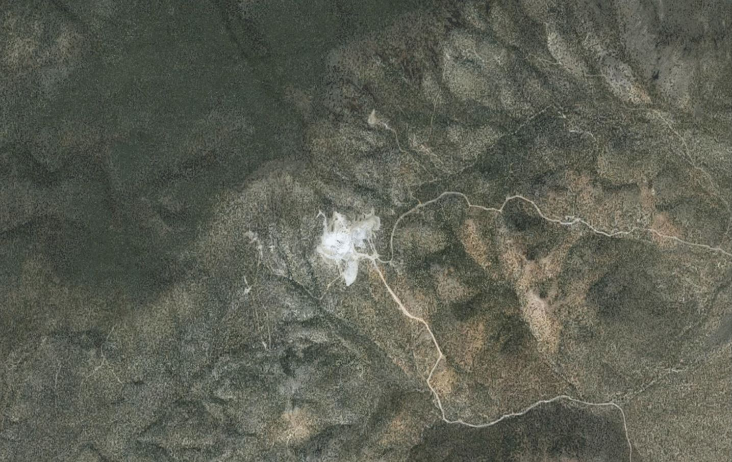
Notes:
Let’s begin with an overhead view of the red emerald mine site as it sits in these mountains…taken from Google Earth.
The perimeter looks like a small white butterfly in the center of the screen. Advance the slide to overlay these claims with the footprint of the much-bigger Brush-Wellman Mine.
Brush-Wellman is the only source of beryllium in the United States. On December 12, 2008, the Department of Defense classified beryllium as the only “strategic material…critical to national security.” In some sense, everyone who has ever received a red emerald from me…is a victim of my Brush-Pass. Although most of its operations are underground, the Brush-Wellman surface footprint is still much larger than the Wah-Wah site. While the Ruby-Violet claims may appear small by comparison…this should never be misconstrued to mean that its subterranean operations are insignificant.
The general consensus is that mining at the Ruby-Violet is not feasible. The host rock has the hardness of concrete, and the cost of processing is high --- One ton of ore yields only one carat of facet-grade crystal.
The Harris Family owned FOUR Ruby Claims and EIGHT Violet Claims, with the surrounding area designated as “Red Beryl” zones. When the two brothers split their operations between them, Rex Harris took the Rubies, Violet 7 & 8 and half of Violet 5 & 6 (highlighted in red). His brother Ted (Ed) Harris took the remaining Violets, along with the adjoining red beryl claims (highlighted in yellow).
On June 2nd, 2013…I set out to answer one basic question: Could either site sustain a financially viable operation…at any cost?

Slide 3
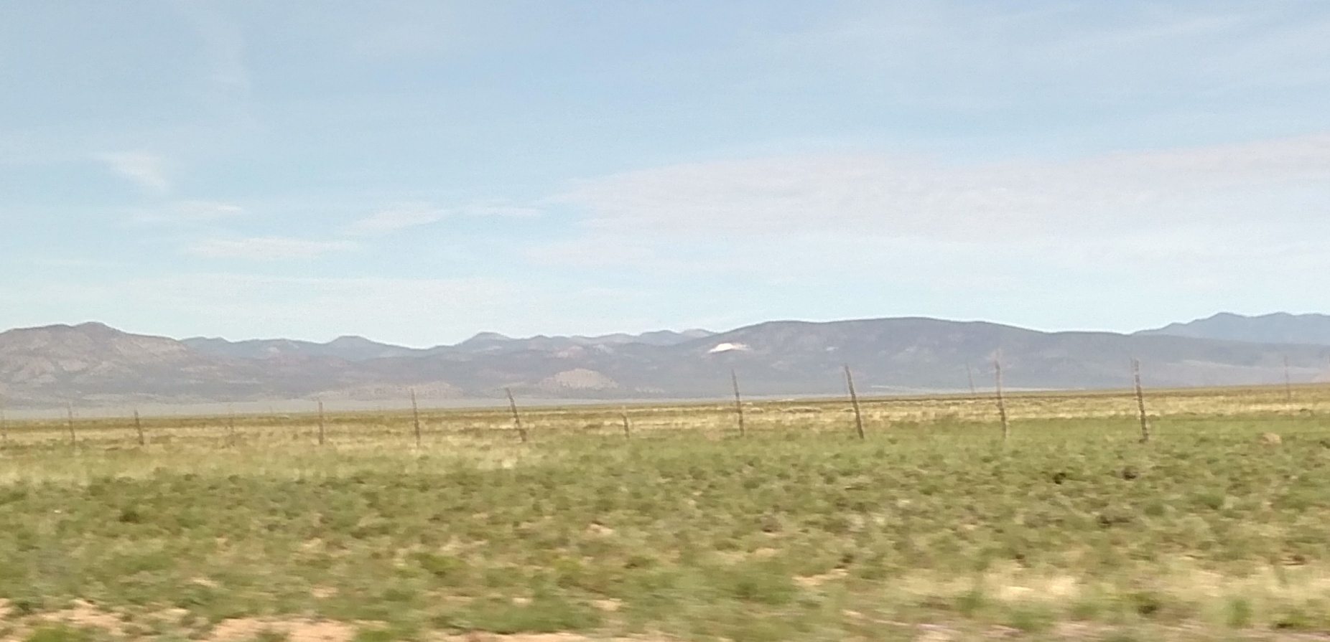
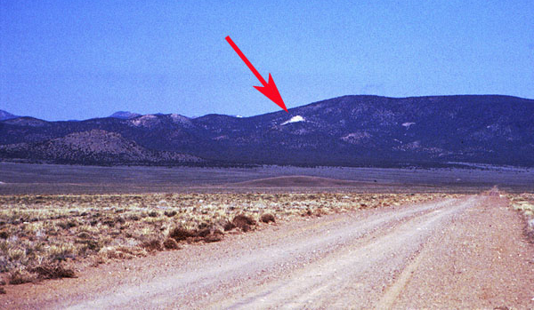
Notes:
Some of the best parts of our Red Emerald adventures were the times my father and I retraced the steps of all those who came before.
At the bottom right is one of the first photos of the Ruby-Violet Claims…published by the Lapidary Journal in March 1979. This picture was taken by John Barlow from 8 miles away.
Red Emeralds grew in a rhyolite that is a bright, snow white…so the exposed rock stands out starkly against the mountain’s natural vegetation, even at a great distance. If you go to Utah and drive to the Wah-Wah Mountains, you’ll think you’re close…long before you ever are!
Above, I tried to recapture the magic of the original shot from a highway almost ten miles away (with fencing).

Slide 4
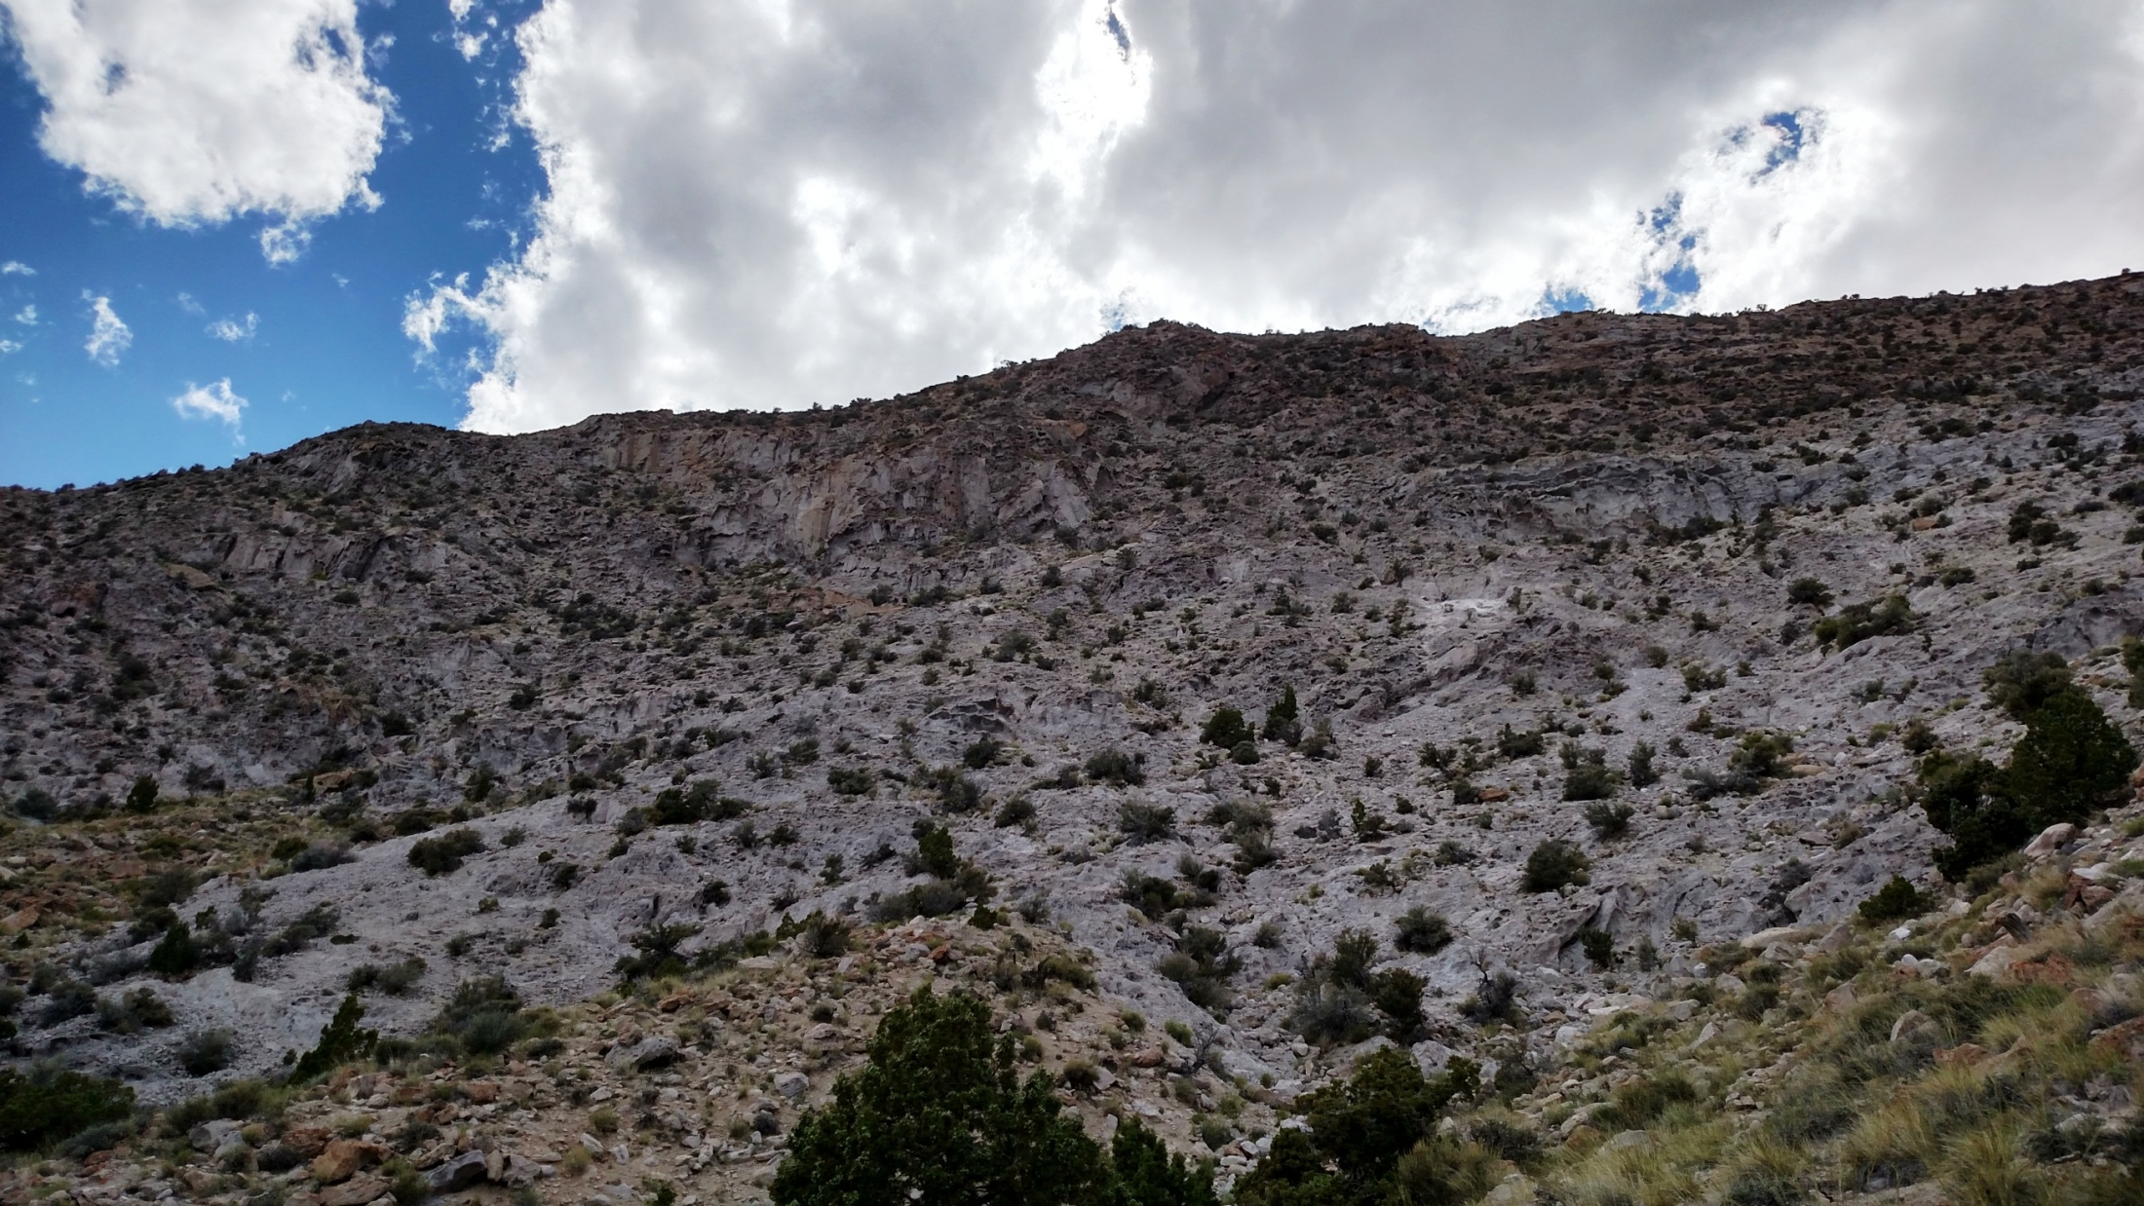
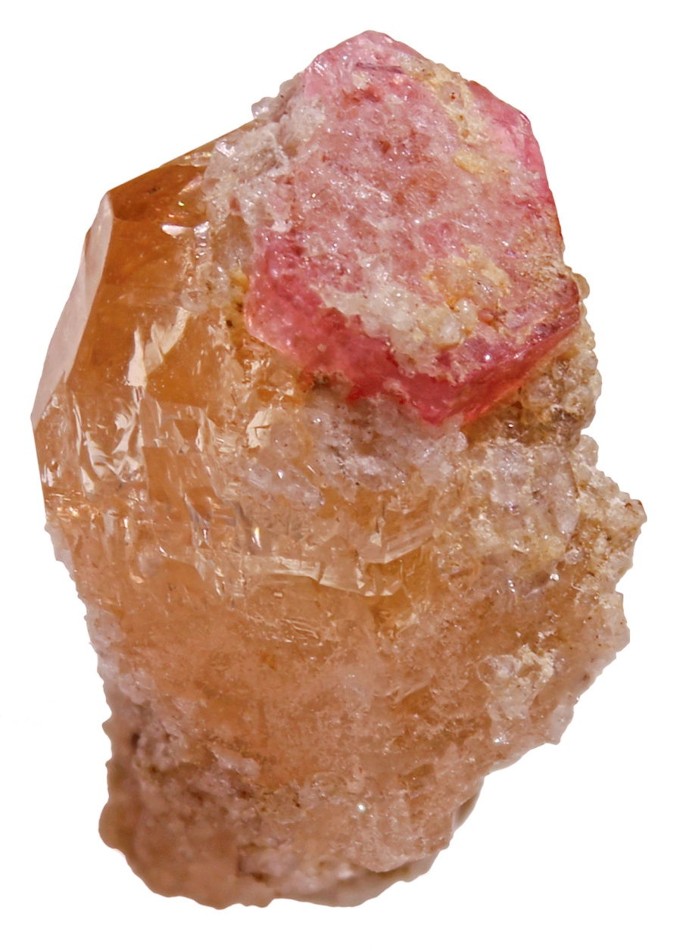
Notes:
This is Topaz Mountain in the Thomas Range…less than 100 miles from the Wah-Wah Mountains. This location is where red beryl was first discovered by Maynard Bixby, back in 1904. Because the government made this land into a National Park, anyone who visits America can go to the same place to recover a specimen for themselves.
John Holfert wrote a Field Guide in 1996 on the minerals that can be found in this area, along with the exact spots (and hand-drawn maps!) where one can find them. When you drive into Topaz Mountain, go past the private claims; with the road at your back, look up and slightly to the left. Even though people have been digging at this site for over a century, the Land Department limits everyone to the use of hand-tools…severely restricting the amount of materials which can be processed. Even after a hundred years, only a little ground has been disturbed…but because it’s white rhyolite, even a novice observer can identify the brighter, red beryl-bearing zone.
Can YOU see it? Click to proceed in the slide show to reveal the location.
While the ledge in that red circle appears close…the hike takes at least twenty minutes from this point and is somewhat taxing, physically.
On my first trip, I plucked a beautiful red beryl wafer on topaz from the deposit…so, I can tell you from personal experience that I know firsthand these hexagonal crystals are out there!

Slide 5
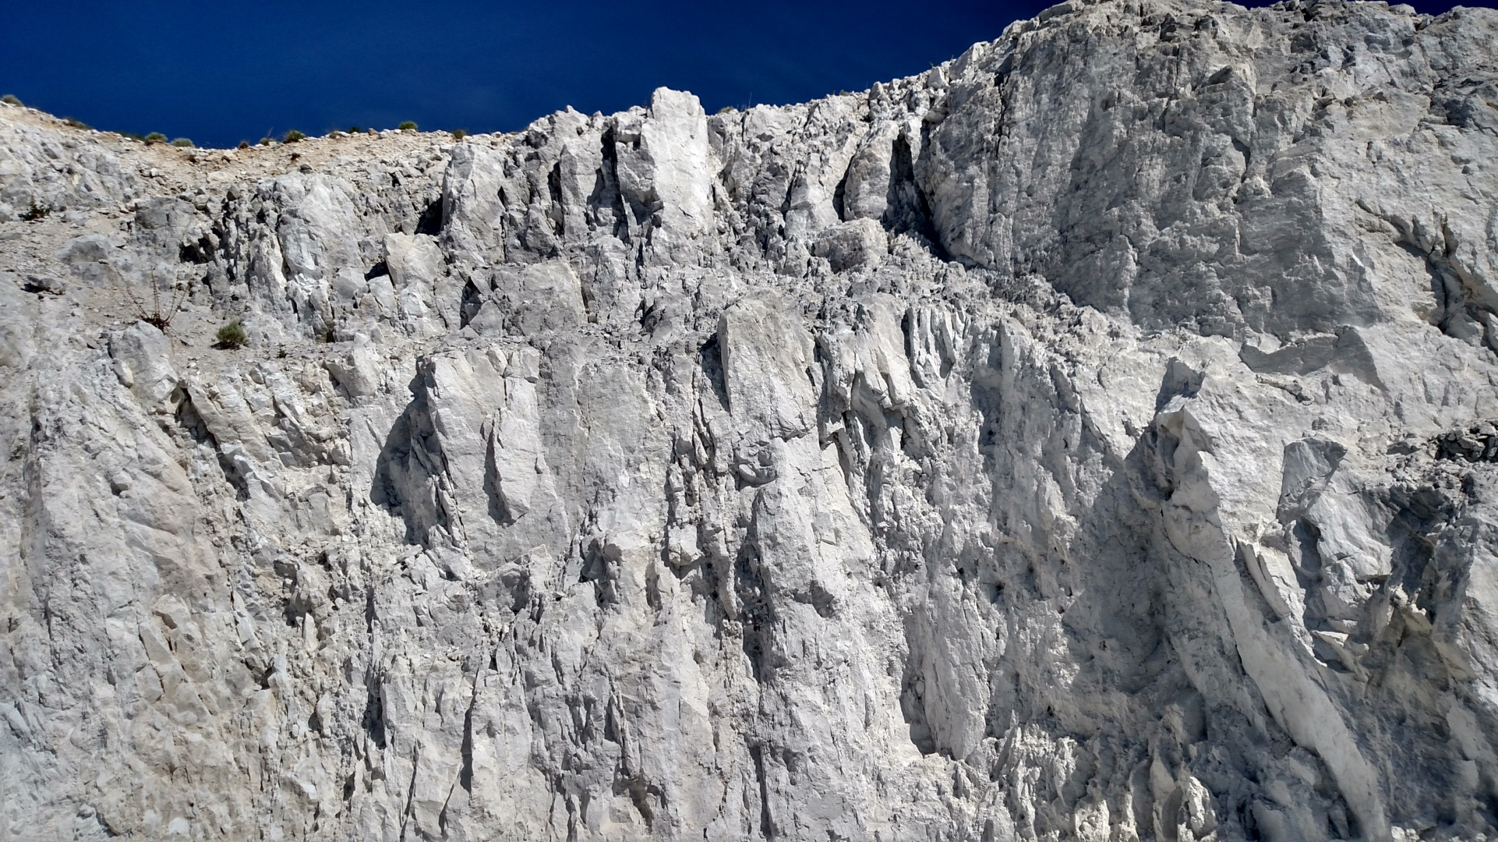
Notes:
The reason why nobody takes Topaz Mountain seriously is because there…they’ve just dug chicken scratches in the dirt. Whereas here in the Wah-Wahs, they blew off the top of the mountain to get to this part. It will take another two to three centuries to arrive at this same depth in the Thomas Range.
When you’re in the Wah-Wah Mountains…you are beset on all sides by a blinding, intense light. This photo of the white cliffs of the Wah-Wahs was taken by me. Somebody whispered in my ear that this place where a huge chunk is removed is called The Cathedral (the Purple Zone on Slide Thirteen). Note the cracks in the wall --- inside these are where the crystals formed.
One of the main differences between the emerald beryls and the non-emerald beryls is the conditions under which they crystallize. Colombian Emeralds grew in tight mica schists, while red emeralds grew in these tight rhyolite fissures. Both geological conditions that created the higher pressures experienced during crystal formation were ultimately classified as the SAME type of hydrothermal events. Those increased pressures cause these beryls to carry a greater load of the inclusions responsible for giving emeralds their intensely-saturated colors.

Slide 6
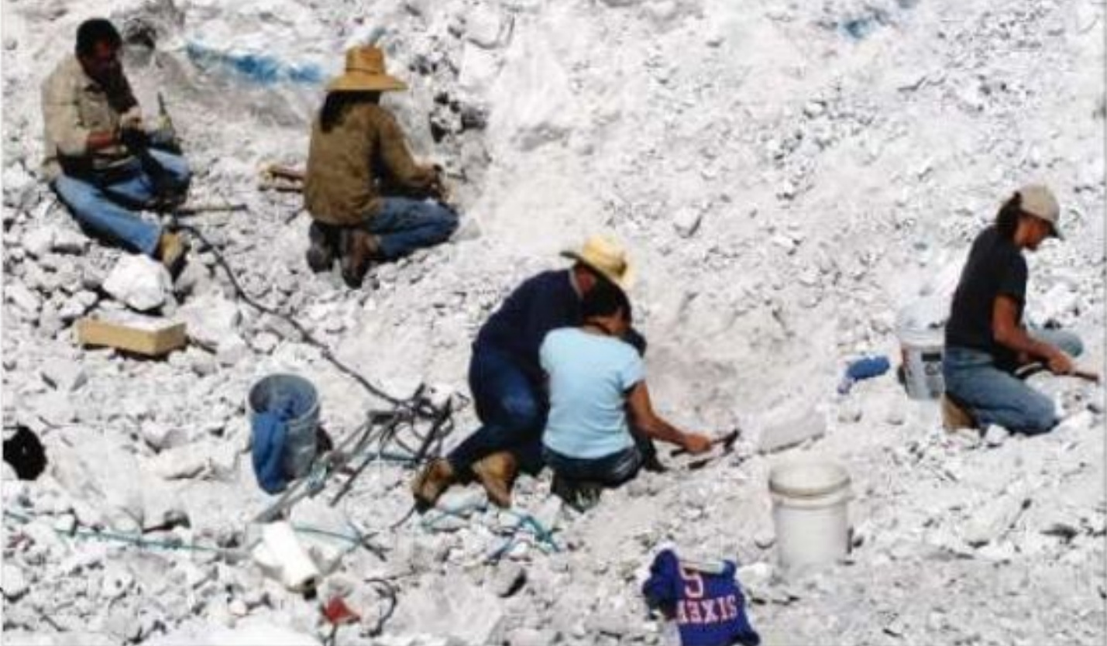
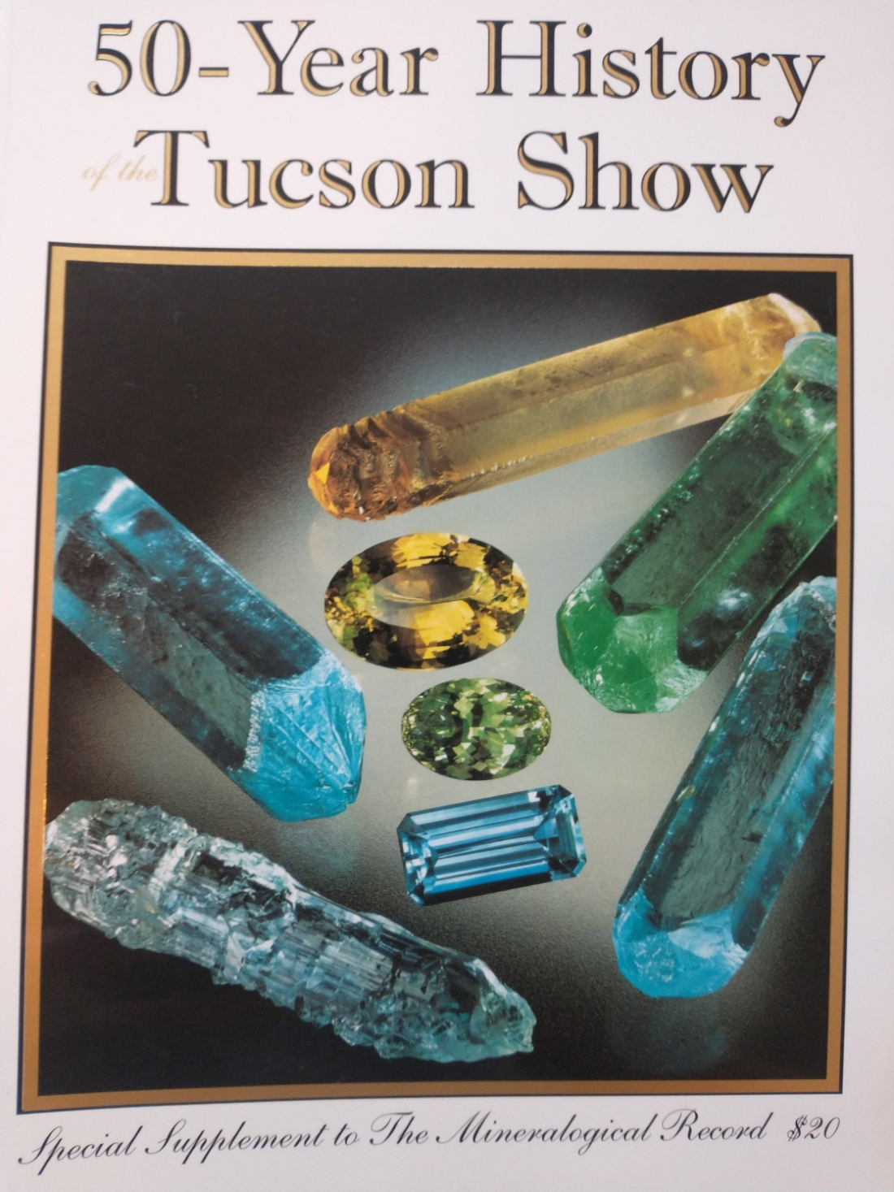
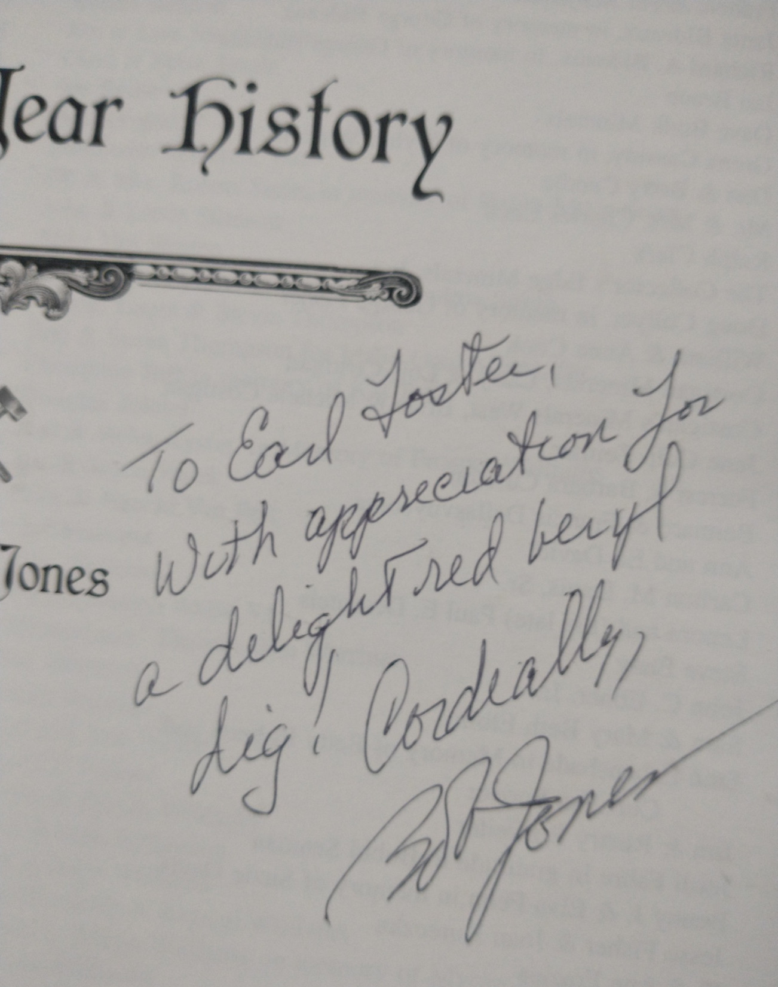
Notes:
This mining photo was published in the October 2010 issue of Rock & Gem magazine, claiming that the “lucky group…included Marc Miterman, Bob and Evan Jones, Marlow and Jean Cropper, with Clay and Jennifer Holman.”
They were right to describe these people as fortunate…because it IS an honor to dig out here. This place is so romantic. Poetically…it’s part of our reason for why violets are blue. Wendell Wilson said to see “red beryl in the bright sun is almost a religious experience.” This feeling is even more intense when you pull a specimen from the ground yourself…and realize you are the first human being to see that crystal since it formed millions of years ago! The photo on the bottom right was taken by me during our first visit to the mine in 2017. It shows a small hexagonal wafer as they are encountered in nature…within the fractures of these hard rhyolite rocks.
When I bought the files and records from the mine, I discovered a copy of a magazine Bob Jones gave to former owner Earle Foster as a gift for allowing them to visit the site. In some sense, the romanticism of Bob’s 2010 article served as part of Earle’s cover story…because the methods visitors use at the mine to find specimens are NOT the same ones any serious operation would employ to produce the maximum number of crystals. Hand-recovery cannot process even close to the same amount of volume industrial production is capable of.
It’s just the most-fun way to find them…especially if you’re an old rockhound like me!

Slide 7
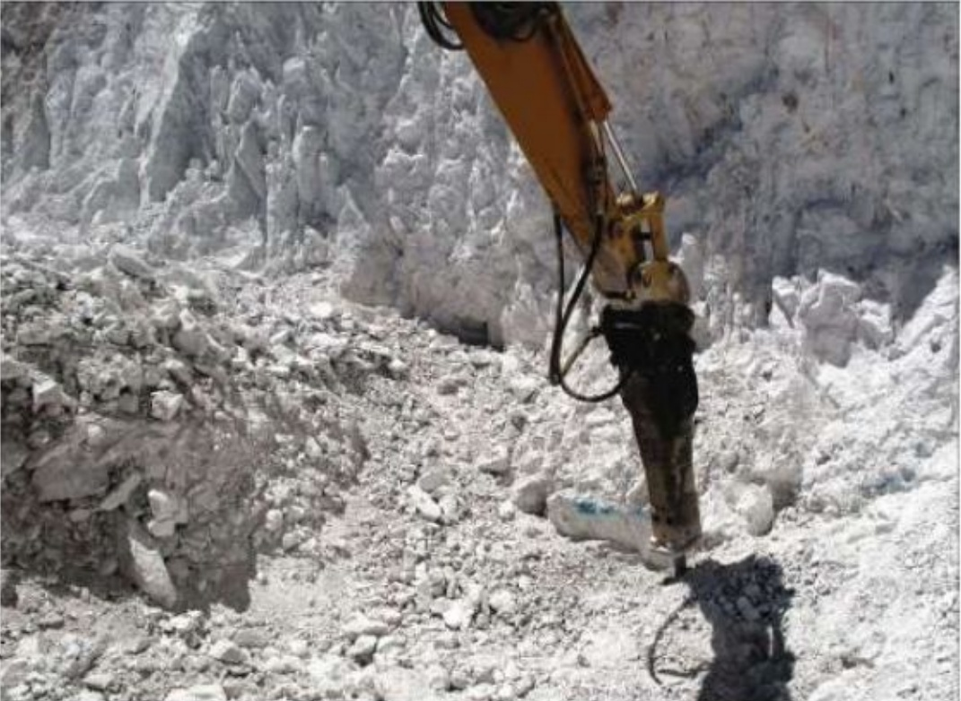
Notes:
The first major difference between professional and amateur operations is HOW one digs for crystals.
To Bob’s great credit, his 2010 article not only covered artisanal mining techniques…but included photos of some alternate ways a greater volume of rhyolite can be processed. To break down large pieces of rock into manageable chunks more quickly, powered hand tools can be utilized. To create higher quantities of ore still, mechanized equipment can be employed. Initially, explosives were used to remove a huge section of the mountaintop…and a heavy amount of debris from that operation still covers much of the site.
No matter how many tons of rocks a person is able to chip away from the mountain face…they will still be left with a finite amount of materials.
The real question is…HOW MUCH of this earth can one man efficiently consume?

Slide 8
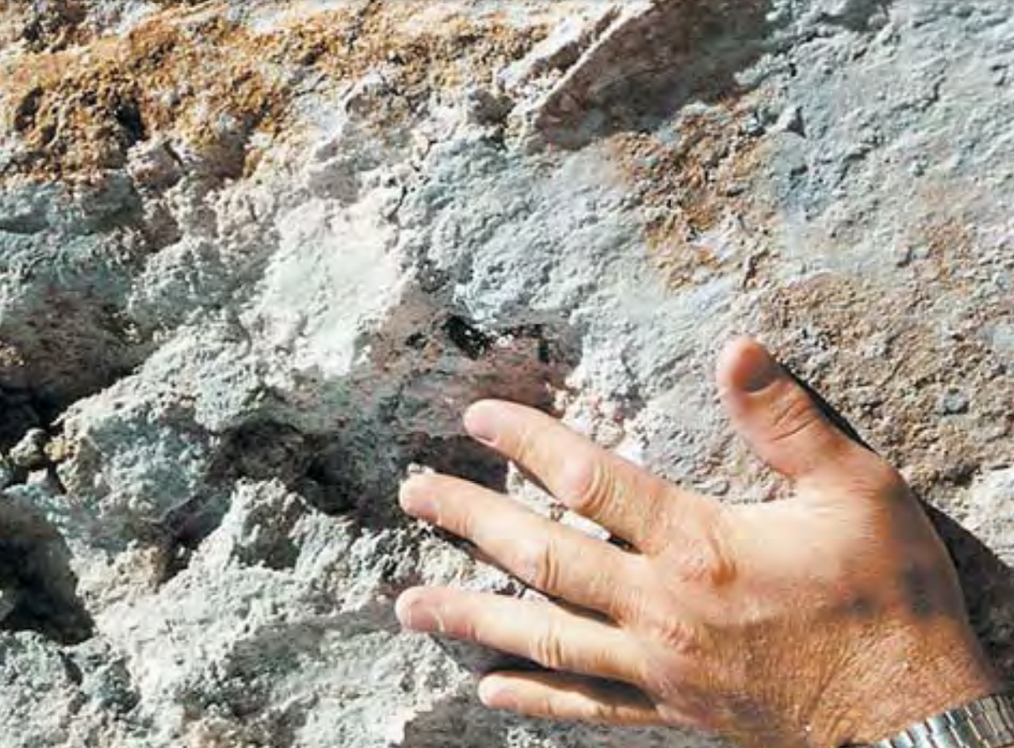
Notes:
The second major difference between professional and amateur operations is WHERE one digs for crystals.
While it is true that red emeralds can form in any rhyolite seam…some cracks are more productive than others. The yield from ore in the Wah-Wahs is often-reported to be one carat of facet-rough per ton. However, Kennecott put a lot of work into specifically identifying “brecciated zones” where the production was reported to be as much as fifty to one hundred times higher!
In this photo published by Gems & Gemology in the Winter of 2003, Rex Harris pointed out the area an inch above his hand as a place where red beryl crystals were found.
Colored ore is an indication that a rock carries a greater variety of minerals. The orange path that begins at the top left of this photo and winds down towards Rex’s watch is a drift of Iron-Stained material. The next signs are the tiny black crystals of bixbyite which appear to be embedded inside a fissure (click to see the black-lined crack). Red beryl mineralization is encouraged by the presence of bixbyite, as it can lead to the nucleation of new crystals…so fine red emerald facet specimens are more probable anywhere along this fracture-lined zone.
Over many years, water passing through this rhyolite deposited dust into crevices…and these regions of smooth, whiter clay can be identified as areas of likely production (click to see the encircled Ice Cream Rock).

Slide 9
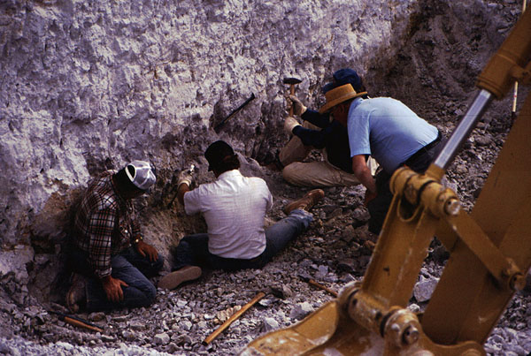
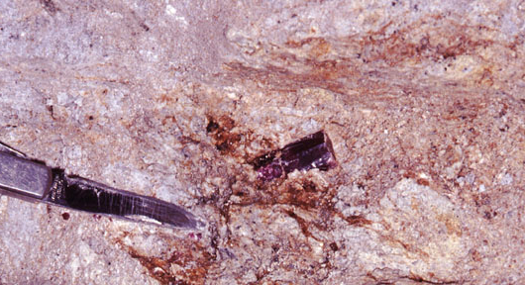
Notes:
The two photos on the left are from Bob Jones’ 2010 expedition, where they recovered the crystal on the bottom left. This is a very fine specimen, with an extra platform and a beautiful sidecar. The matrix composition where this crew was digging consists of a very dense, intensely-white and compact rhyolite. This is the reason the crystals there are typically more-included, as shown.
Compare that to the crystalline specimen on the bottom right. Note the darker and deeper color of this crystal from an iron-rich vein. I suspect the enriched drift (brown area in the bottom-half of the top right photo) may have been less-restrictive at the time of mineralization…but I could not verify first-hand any differences in these two distinct forms of rhyolite composition. Drifts near the surface which were the most-easily-accessible have been mined-out since the 90s…and I was only ever able to collect a handful of matrix pieces from this era.
Finding larger, gemmy crystals in the whiter material may be more-rare…but clearly, as Bob Jones proved, it is still possible. If a facet-grade gem can be cut from these types of more-included crystals, the jewels are no-less-valuable…if anything, those are probably worth even more.
However, a prudent investor would seek to recover as many as they can in the quality grade seen at the bottom-right.

Slide 10
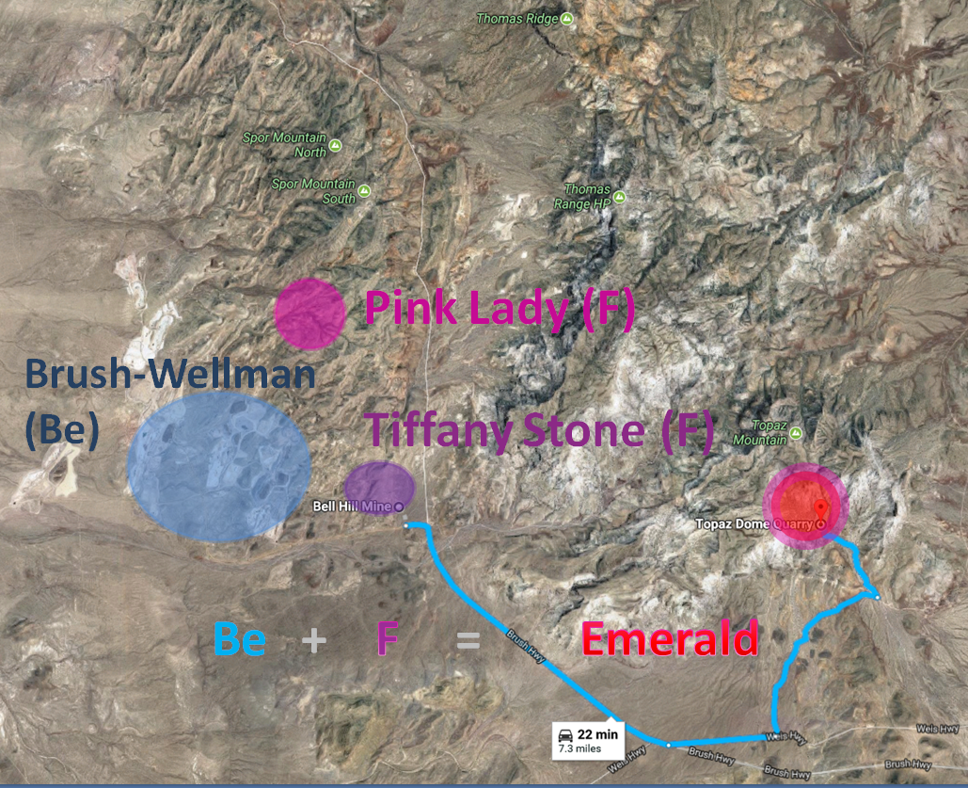
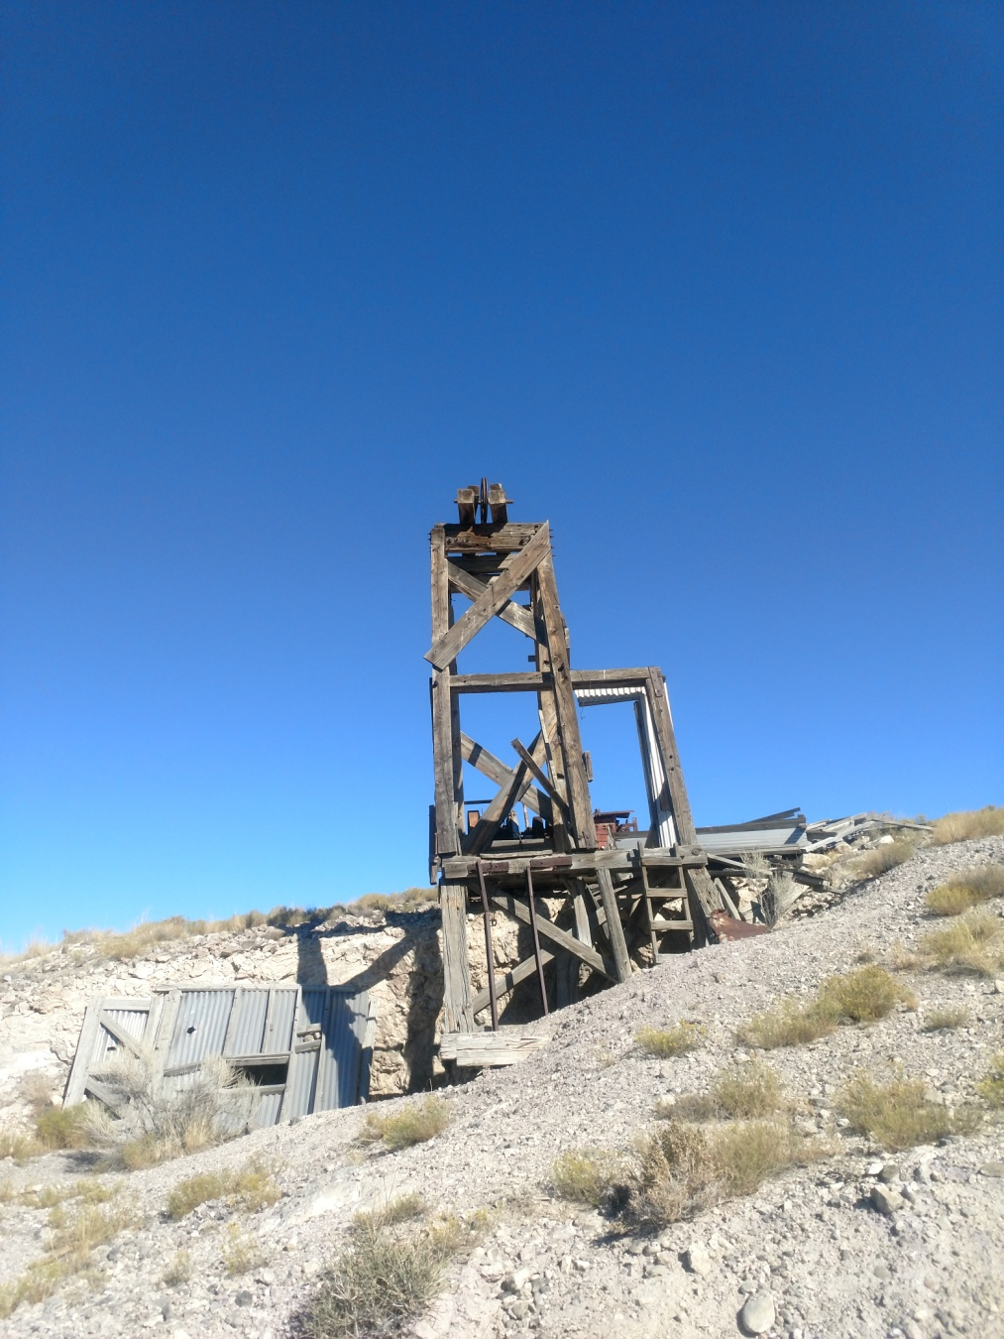
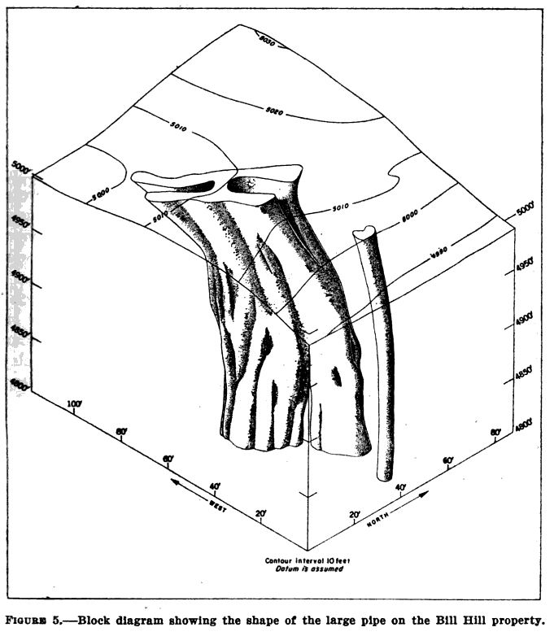
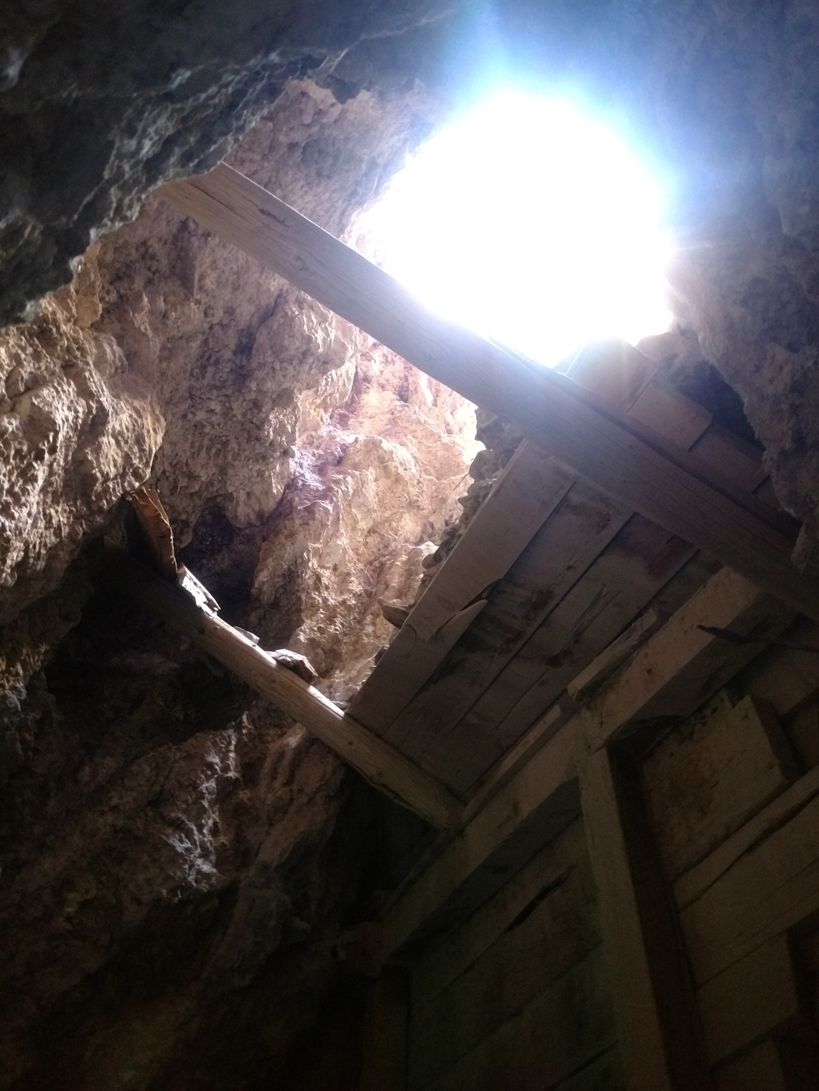
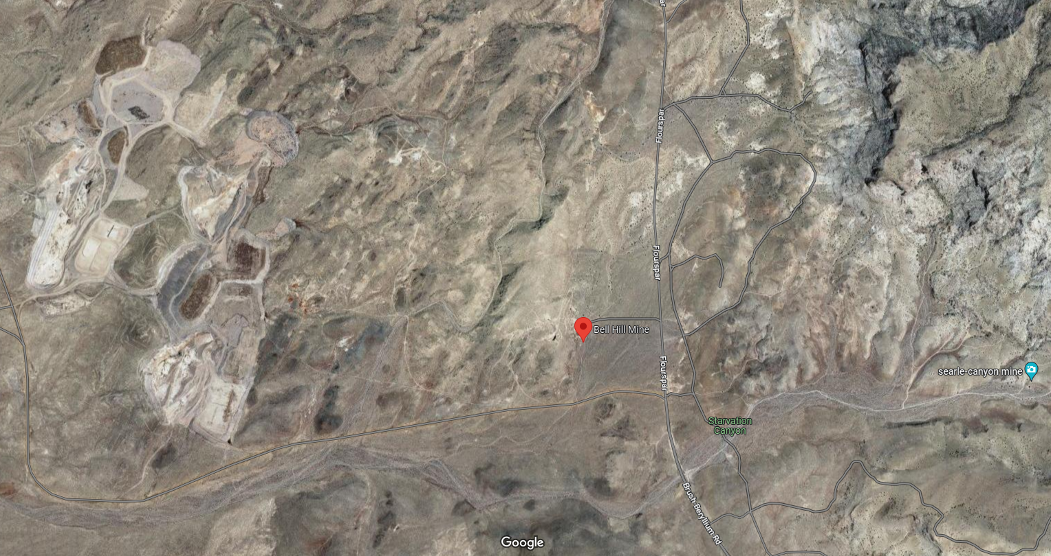
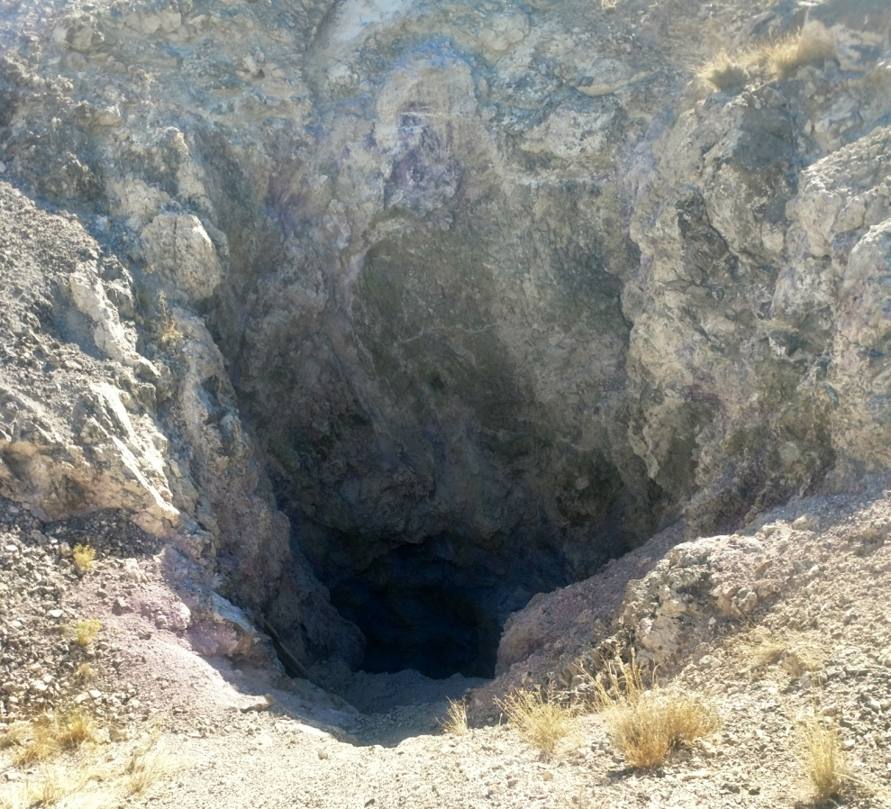
Notes:
My father and I used to own the iconic Bell Hill Mine. True story.
This is only one tiny mineral finger shooting off of the primary Beryllium deposit at Brush-Wellman (who also owned Bell Hill, at one time) and is located less than a mile and a half away from the main vein. Fluorite is known to induce crystallization in a number of scenarios, so the presence of both these elements in close proximity is conducive to emerald development. Starvation Canyon (where red beryl have been found) is less than 2,000 feet from this location. Topaz Mountain is under five miles away.
This is a massive concentration of purple fluorite, with a thick central vein of crystals plunging hundreds of feet deep into the Earth’s crust (or dozens of architectural stories down, at least…think of the photo on the bottom left like standing on the edge of a reverse skyscraper). Bell Hill is an example that what occurs on the surface in the mining world can sometimes pale in comparison to the amount of material which is recovered beneath. Disruptions above-ground are almost imperceptible…but the hidden work stretches for thousands and thousands of meters underfoot.
When I visited our claims in-person, I suddenly realized that this hole…goes all the way down into the bowels of the planet! But seemingly, there were little to no safety features whatsoever put into place by the original miners. Ultimately, I determined that the risk of ownership --- with a potential liability of someone inevitably falling to their doom --- could very well bankrupt me! Therefore, I felt it best to let the site go back to the custody of the State.
Even if the main pipe here has been hollowed out…the old miners always left behind a few scraps embedded in the ground surrounding the primary material. Look at the seams of bright purple colors (highlighted under the red lines) that sink deep into the Earth’s crust. Call this material “Secondary-Grade Ore”.

Slide 11
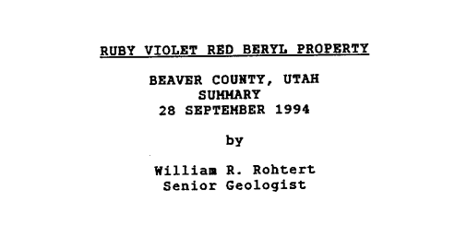
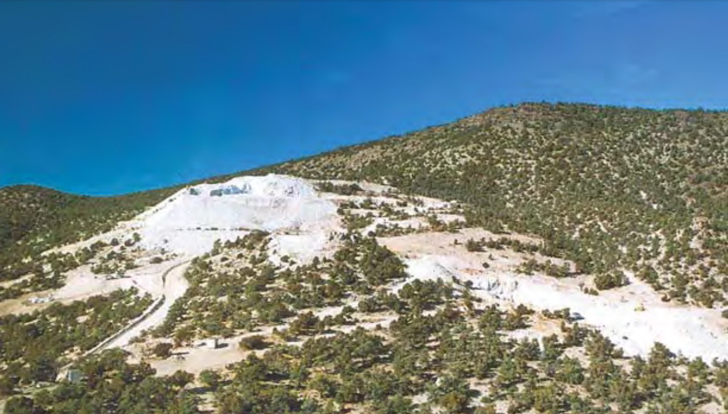
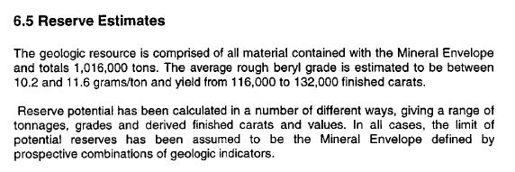
Notes:
This photo was published in Gems & Gemology (Winter 2003, pg. 304) with the following caption, “This view, looking westward, shows the Ruby Violet mine site in the mid-1990s, at the height of exploration activity. Since then, the site has been partially reclaimed, with most of the pits filled in to recreate the original shape of the hillside. Photo courtesy of William Rohtert.”
William Rohtert, for me, will always be known as the man who prepared a Geological Survey/Report on the red beryl property for Kennecott to summarize the reserves in the mineral ‘envelope’ on the property. His photo (taken from the next ridgeline over) is one of the few angles that shows the entire profile of the Ruby-Violet ridge.
The mountain itself is primarily comprised of a low-yielding ore…but there is almost an infinite amount of it. An additional convenience is that a road (orange line) leads directly to the claim site. If one could discover a way to process the material affordably (and with the maximum efficiency), then a sustainable way to consistently produce melee stones might be possible, still. I spent my time at the site trying to gather as many samples as I could…so I would have enough material to run some basic, reliable experiments (if I ever needed to solve this problem).
However, the most PROFITABLE zones are the previously-identified, darker, mineral-rich drifts. Kennecott punctured the mountain with dozens of core samples. These were sunk at different angles, penetrating the envelope like a pincushion. Imagine the sampled cross-sections as sticks inserted at different entry points (shown in the children’s game overlay).

Slide 12
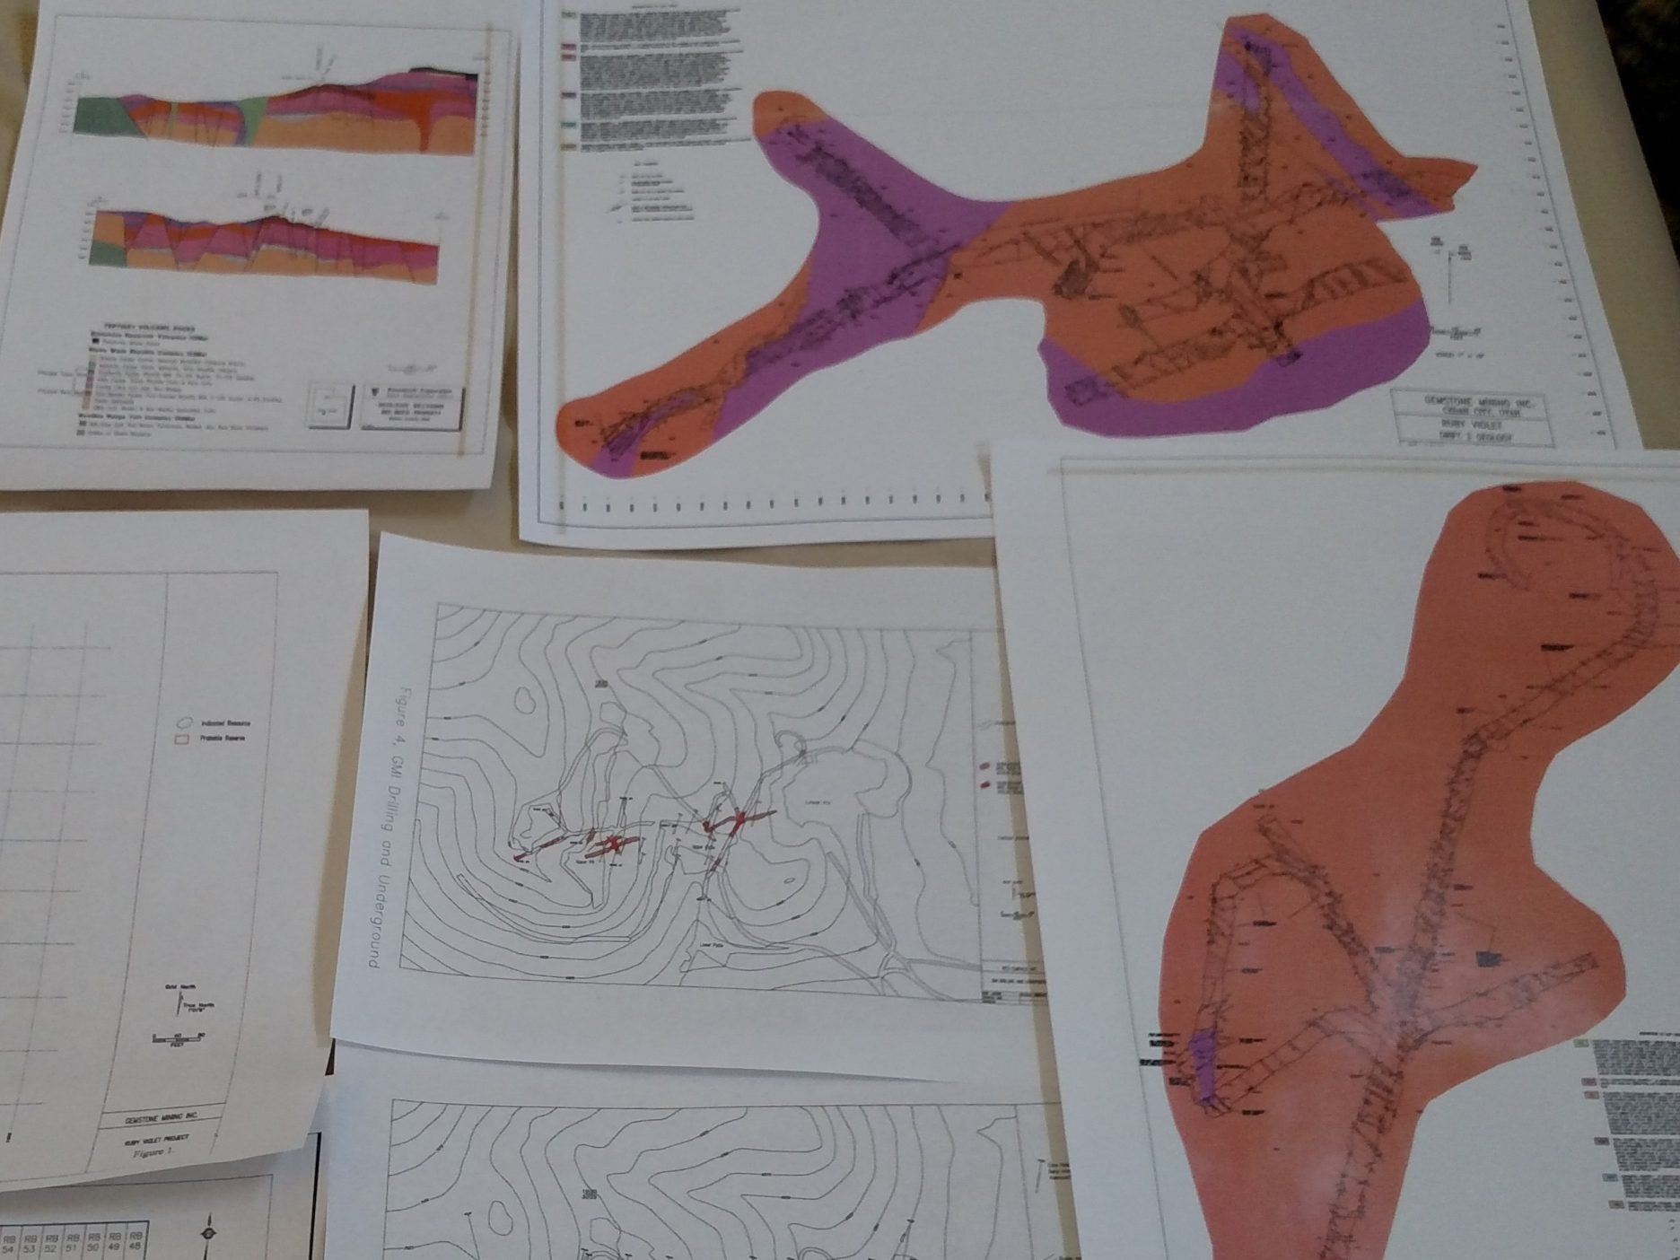
Notes:
When one of the ‘sticks’ from that children’s game was removed from the mountain in real life…the workers were left with a two-inch thick rod of rock hundreds of feet long! These rods were able to paint a picture of the nature of the subsurface material…with the specific mission of identifying the more-brecciated, crystal-heavy areas.
Each tube was broken down and the composition and quality of the rhyolite was noted at each depth. This is the method they used for mapping the uncharted territory beneath the ground. A number of crystal-rich drifts were identified…and a course was plotted to tunnel into the mountain right through each of these zones.
Remember the three rules of professional digging are HOW, WHERE and HOW MUCH.
Even with their tunneling plan, Kennecott was only able to improve their average yield from 10 grams of beryl per ton to 15 g/t…because they still had to chew through a large amount of ‘regular’, lower-grade ore to get to the enriched zones they were after!

Slide 13
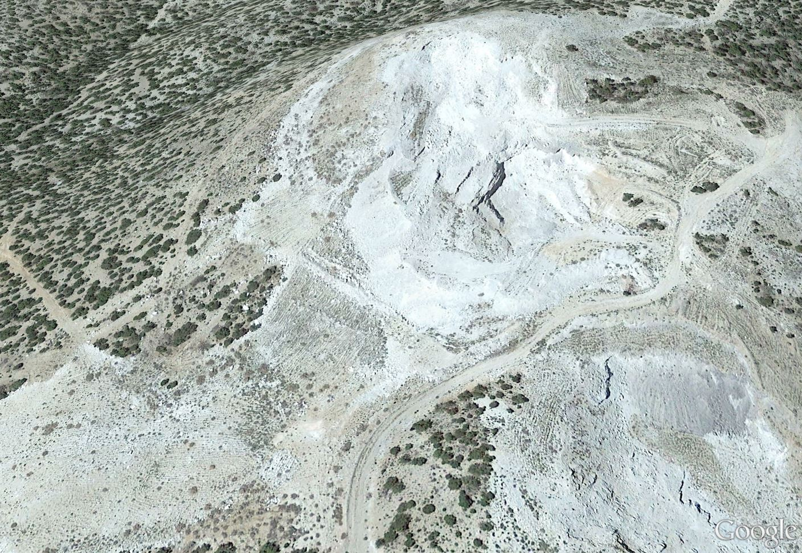
Air
Shaft
X
Entrance
X
Notes:
A closer inspection of the mining area can be seen on Google Earth.
Note that the road driving up and into the property bisects the operation. On the lower right-hand side of the imagery is the first dig site --- Rex Harris’ claims (click for Ruby Overlay). Note the darker color of those tailings.
The bright white mound on the top in the middle with a chunk of cathedral carved out of it belonged to his brother, Ted Harris (click for Violet Overlay). This separate and larger set of claims were later sold to Earle Foster, Kennecott and lastly…the independent company of Gemstone Mining, Incorporated. After 2003, ownership reverted back to Foster and his set of investors.
All of their efforts were able to recover crystals…but Kennecott’s tunneling efforts (advance the slide for an overlay) produced the most tonnage of ore and a greater number of crystals than all previous operations combined.
At the bottom left (click for Jet Black Overlay) is the area that industrial recovery has already consumed. This space has been re-covered by tailings “to recreate the original shape of the hillside.”

Slide 14
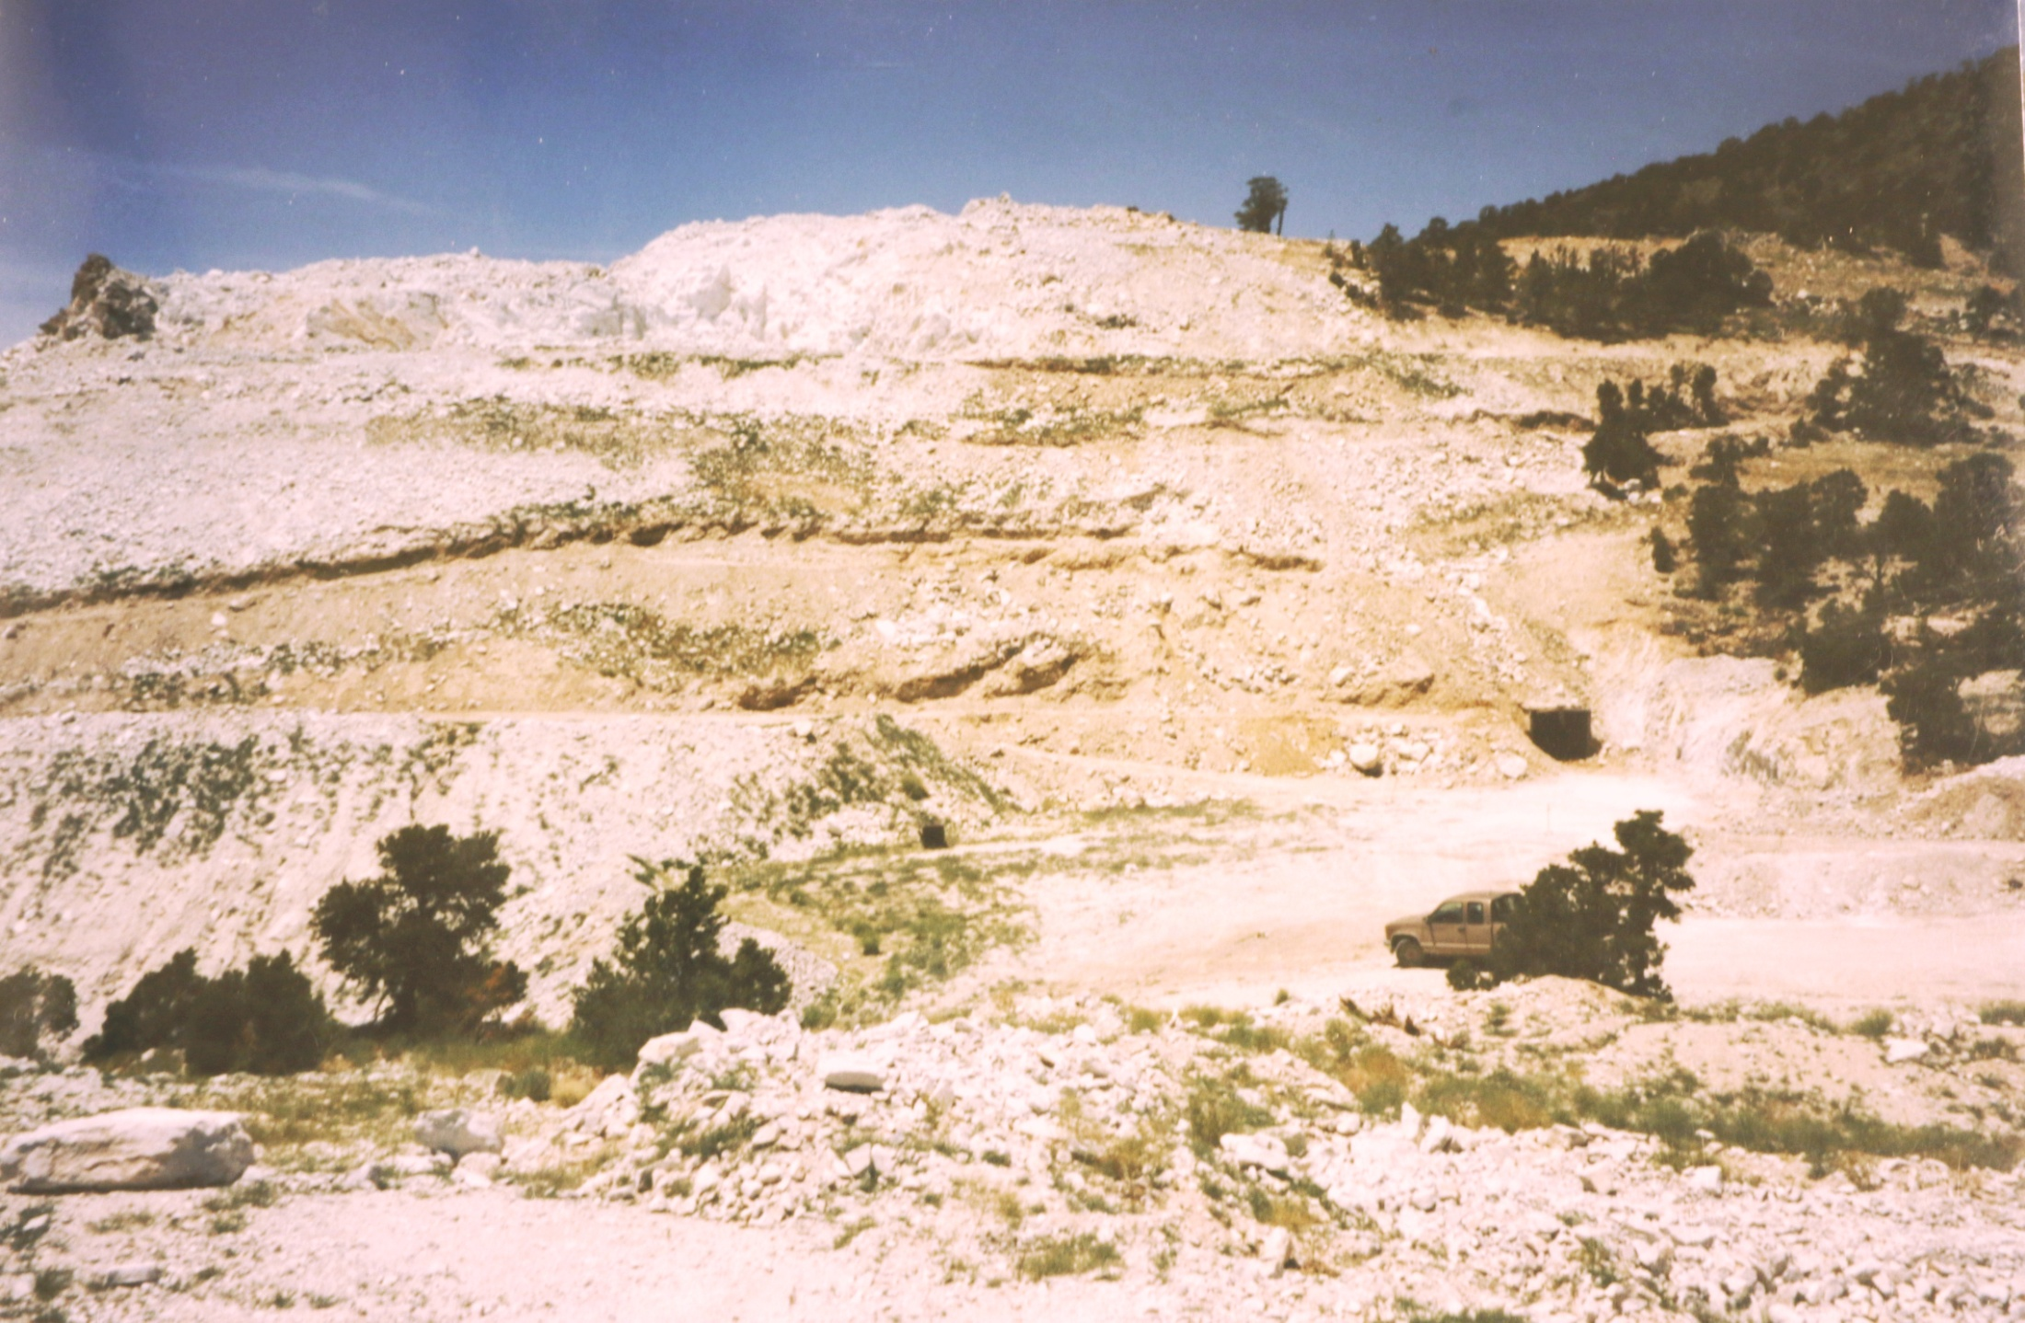
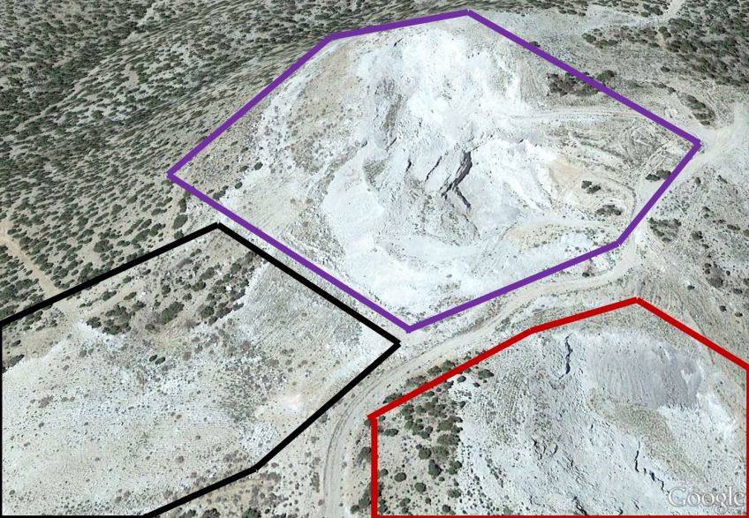
Air
Shaft
X
X
X
Notes:
Perhaps the most salacious rumor I’ve ever heard about the site was in Dominique Merz’s book. His character claimed the mines are “played out” (all the good ore has been taken). Kennecott sampled the entire mineral envelope…but NOT the entirety of the property. Even if they were completely successful in recovering the main pair of drifts they had identified…that doesn’t mean all drifts were identified. Personally, I was hoping they weren’t totally thorough in cleaning out the original deposits during their short run at the mine.
This photo was among Kennecott’s records, and dates back to the 1990s. To provide a sense of scale…look at the pickup truck hiding behind the tree in the bottom right of the shot. Above this is a small black square which I believe to be an old air shaft that led into the tunnels. I could not confirm this during my on-site visits…because that black box is now covered by about twenty feet of fine gravel!
This is a picture from inside the Black Zone…taken at the bottom left corner of the previous slide (Black X), looking up towards the top of the hill. This entire area has been consumed of all resources and backfilled with the rubble of other operations in an effort to ‘reclaim’ the land (restore it to its initial state). This whole talus field is ‘spent ammunition’, in a way…and the fact that 1/3 of the peak is comprised of area that has been ‘eaten’ was initially disconcerting. Another 1/3 of the mountain in the Red Zone is fast-approaching this degree of consumption. However, the space in the Purple Zone was more-or-less untouched, by comparison. Next, we will move from the Black Zone onto the road between this reclaimed area and the Ruby Claims (Blue X), where our perspective will be looking over the lower pit area.

Slide 15
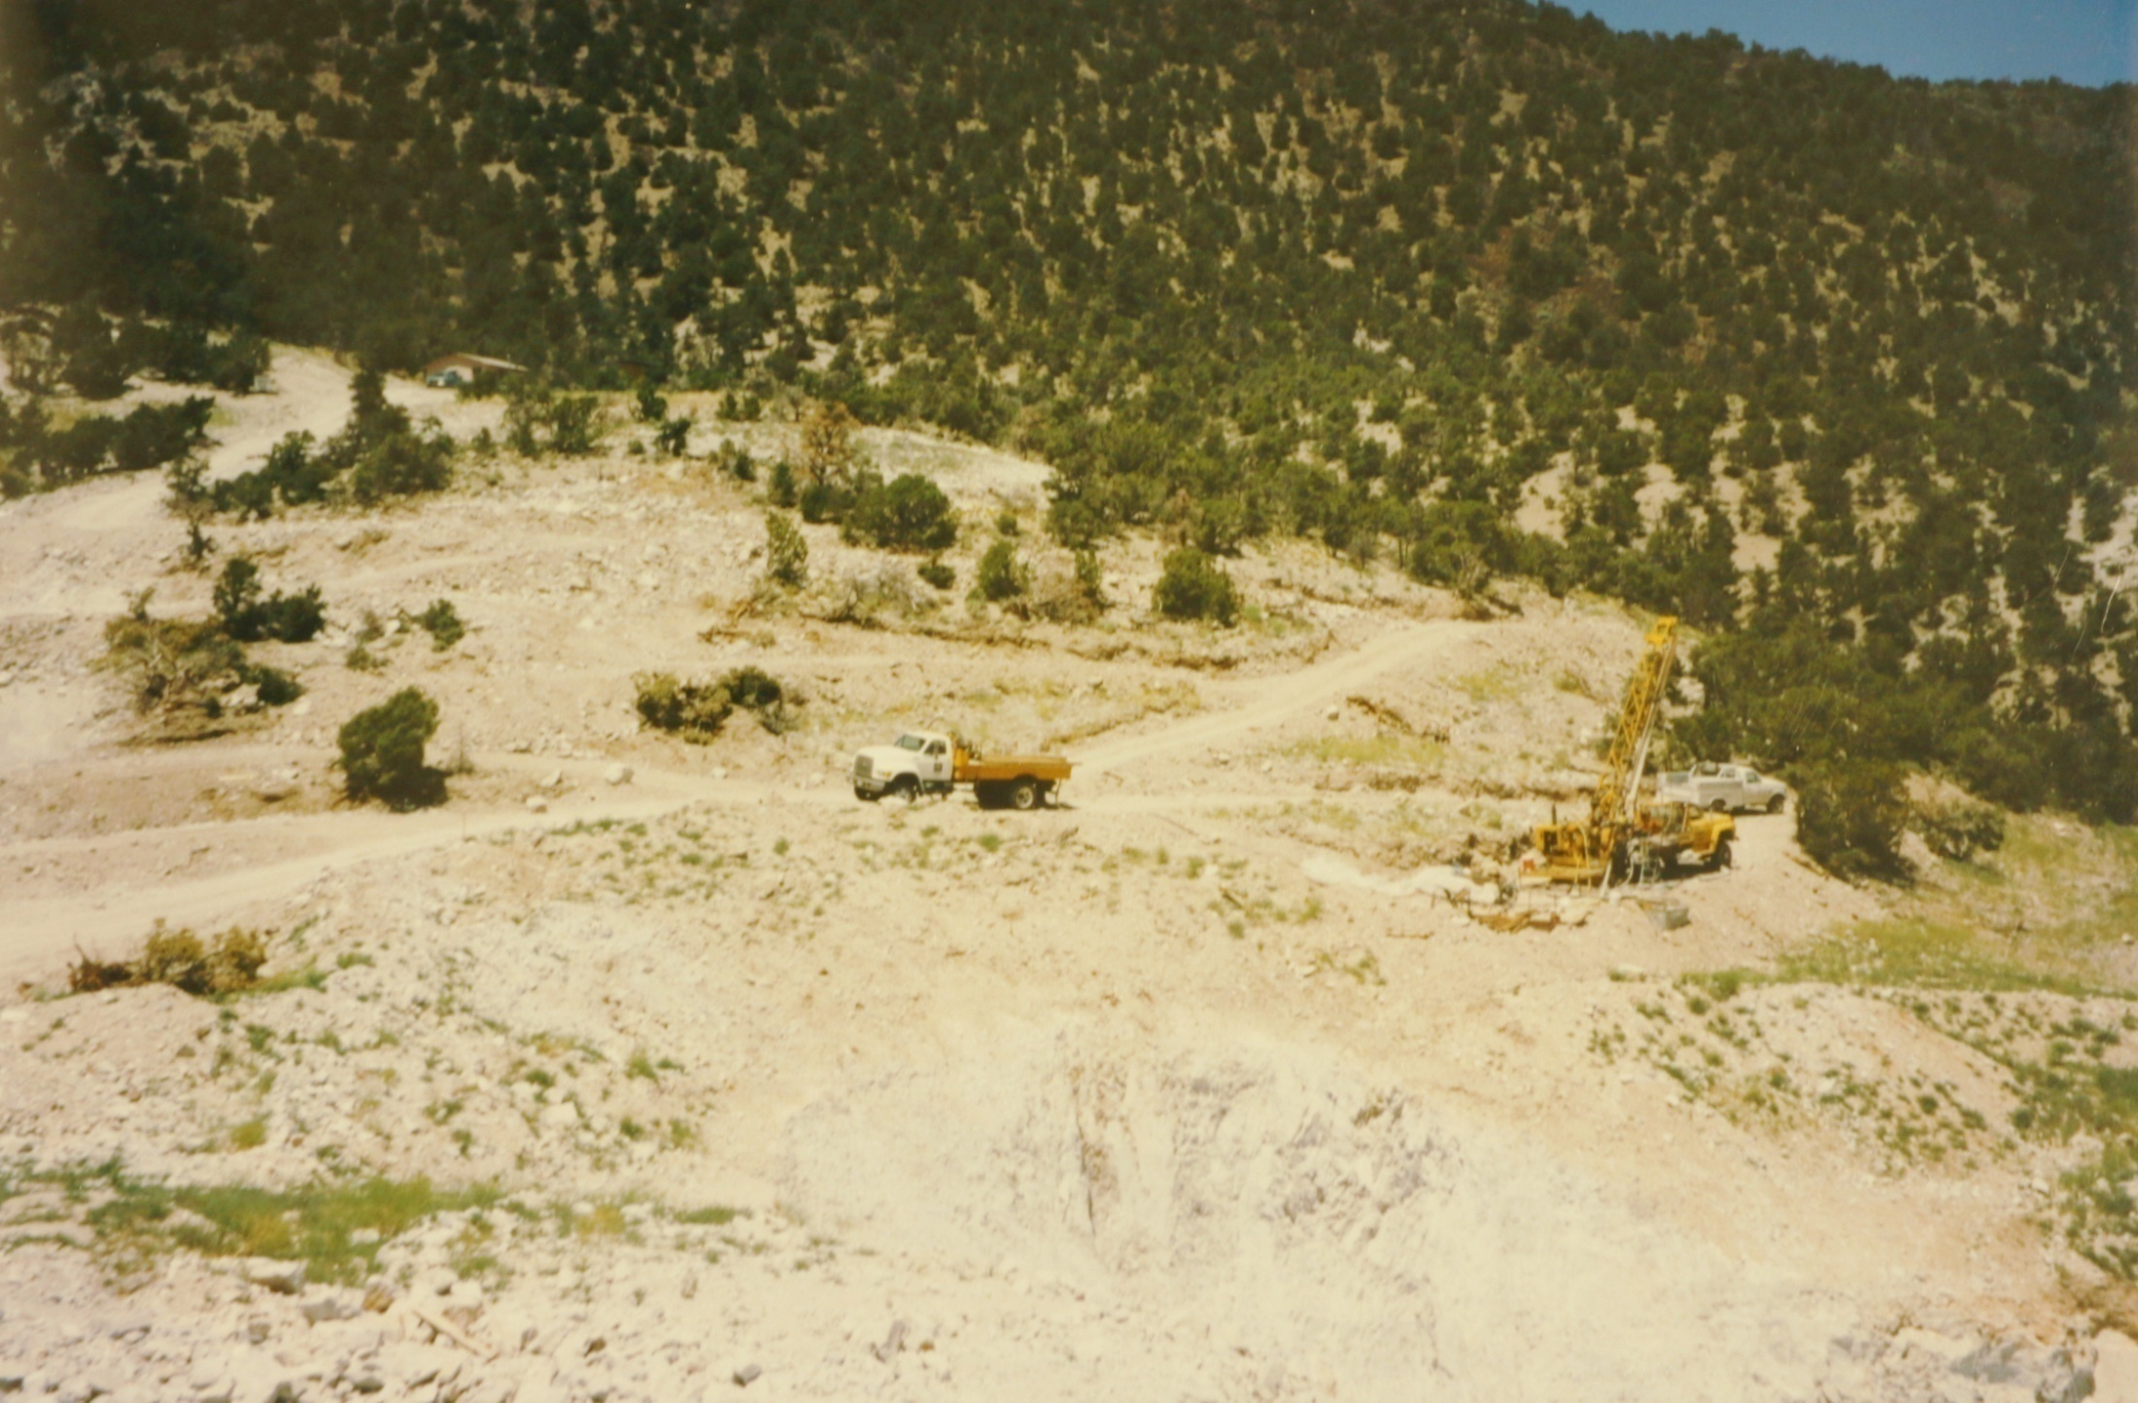
Notes:
On the road between the red zone and the reclaimed area, one can see over the lower pit (bottom right). This picture was taken from records made by Kennecott during their operations of the 1990s.
On the upper left of the ridgeline is a small headquarters shack that was built on-site (click for encircled area).
The Hodges Family discovered this area. And as a reward, they got it for nothing (except nominal staking fees). The Harris Family then purchased it from them for the price of a small car. Corporations plundered the site for all they thought it was worth…and then transferred all liabilities to some random guy off the street. I never imagined the price would be affordable…but I never thought it was unobtainable! Many wonder how much money they could make with a mine like this. I don’t know if any operation would be profitable…but I wanted the property as a place TO LIVE!
Breaking big rocks into smaller rocks is one of the duties of a good convict…but instead of seeing this work as some kind of a prison sentence, I think it would be like living in the luxury cabin of my choosing!

Slide 16
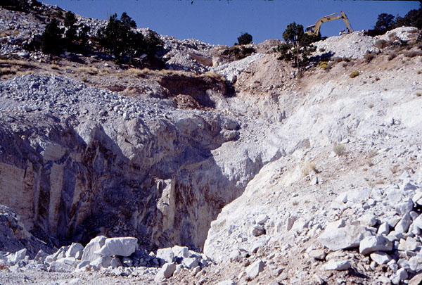
Notes:
Moving further into the Lower Pit (Rex’s Red Zone) allows us to observe several interesting features of the smaller rock face. Multiple sources reported that some of the best crystals were found right where the digging stopped…at the property line along the road.
If the intent of these tunnels was to follow the iron-stained, mineral-rich veins, then I imagine the entrance was somewhat similar in appearance to the bottom left-hand side of this photo…burrowing deep into the mountain. While this hole still exists in the wall on Rex’s property…the depth only goes back around twenty feet.
This was the only access to the underground tunnels, and the entry was dynamited closed at the end of industrial operations in 2001.

Slide 17
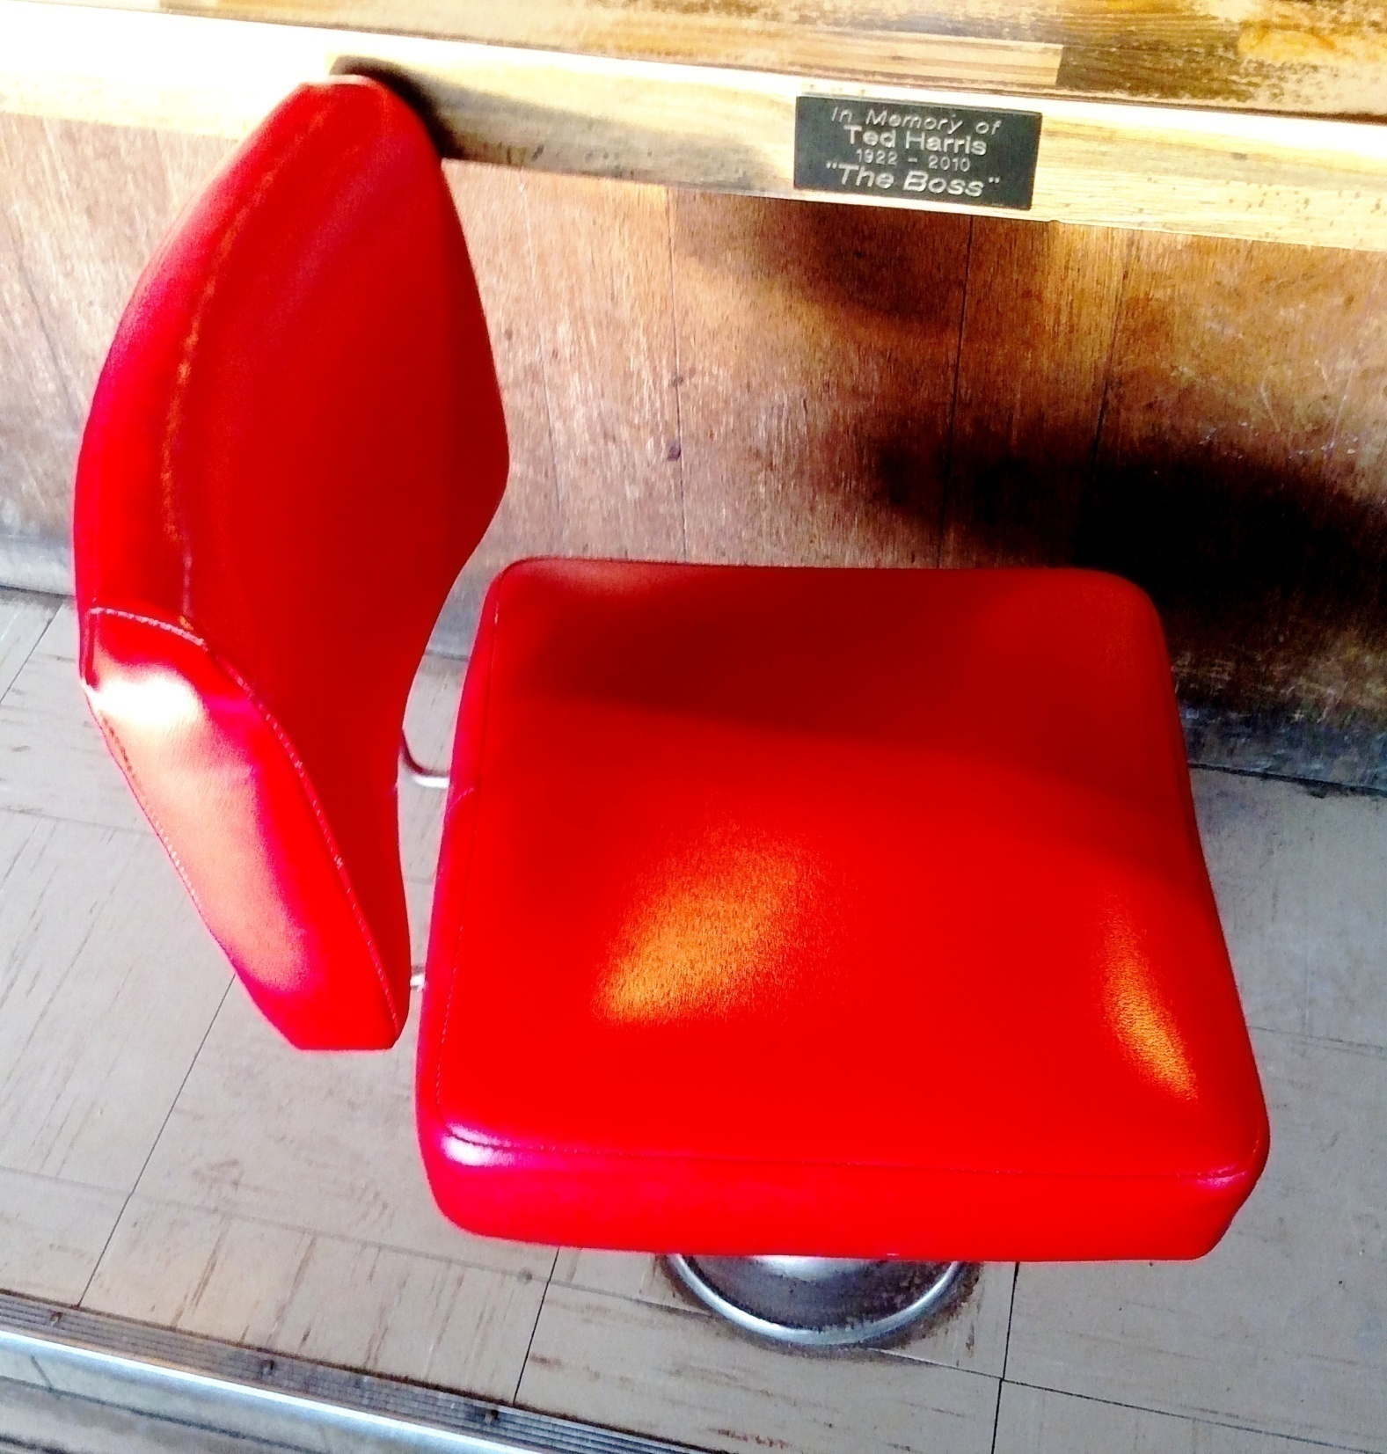
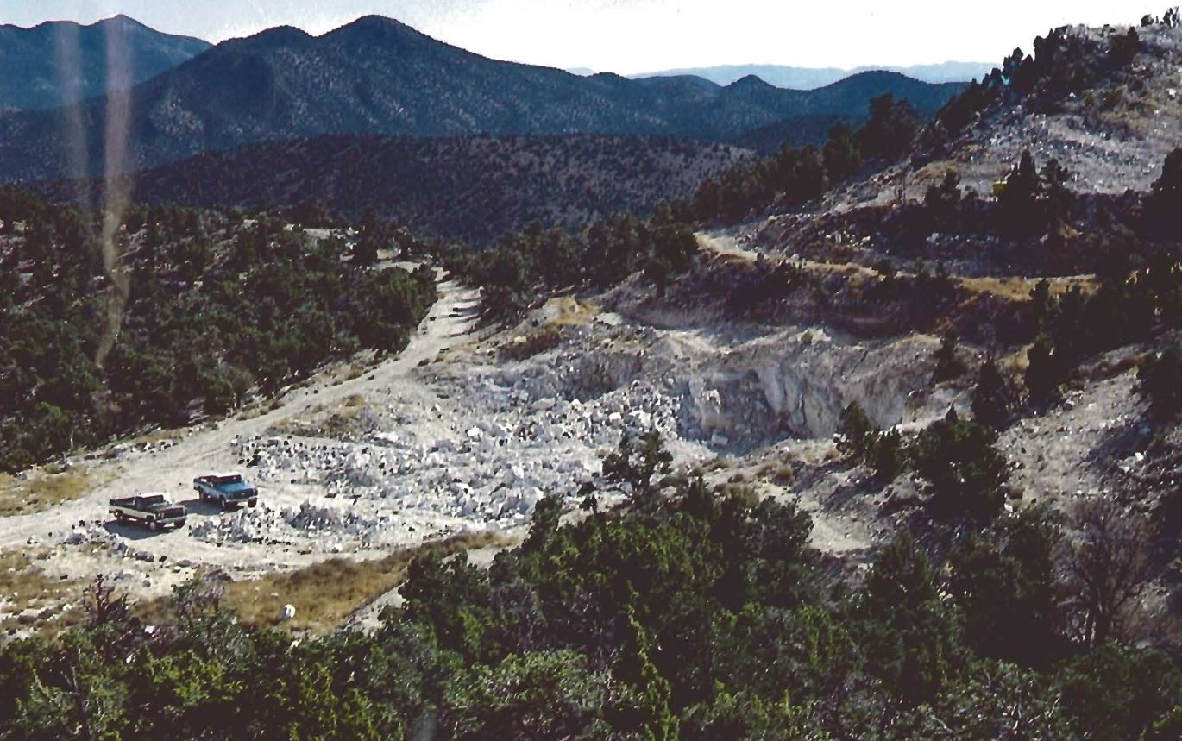
Notes:
Moving past the main deposit and looking back, we can see this gorgeous wide shot of the claims. This photo was published by Gems & Gemology in the Winter of 1984 with the following caption: “View (looking south) of the Violet Claims and the lower rhyolite occurrence that has become more exposed as the result of recent mining activity for red beryl. The Blue Mountain is in the distance. Photo by Ed Harris.”
Ted Harris (as he was also known) owned a diner in the nearby town of Delta, where he had another nickname --- “The Boss”.
An old joke I heard claimed that if you have no legitimacy…you can always see how much it costs to buy you some! Back in the day…Ed was the man to talk to, if anyone was interested in purchasing the claims for this reason. One benefit to being the mine owner is that people in the mineral community immediately see that person’s words as carrying authority…but those who speak the truth about this gem will always have the strongest voice!
With limited funds, I arrived at a financial fork in the road where I had to make a choice between either buying the mine or acquiring inventory. I chose the latter…because in 2013, one could pick up red beryl rough on the market cheaper than it cost Kennecott to dig it out of the ground!

Slide 18
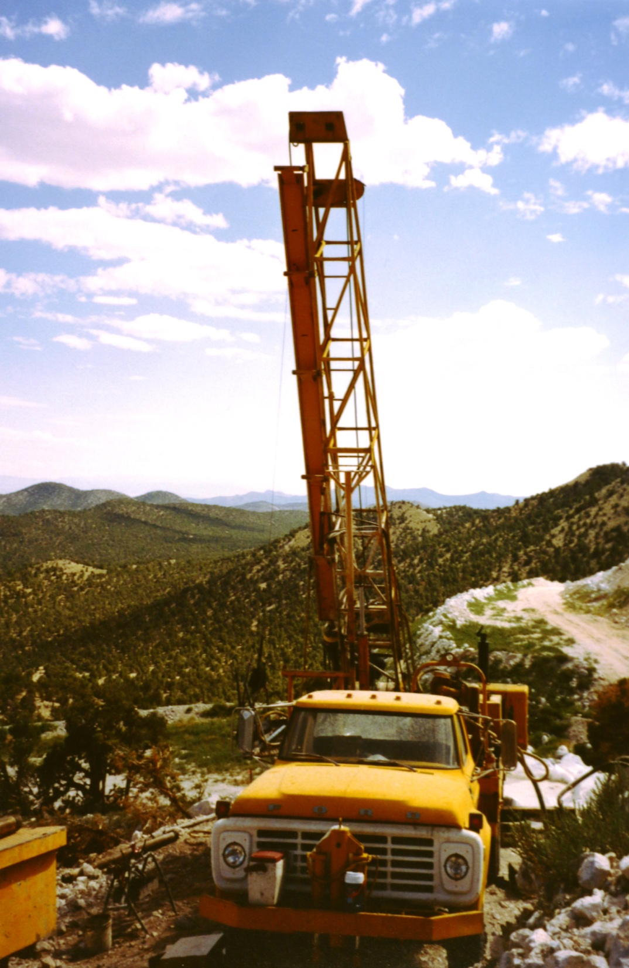
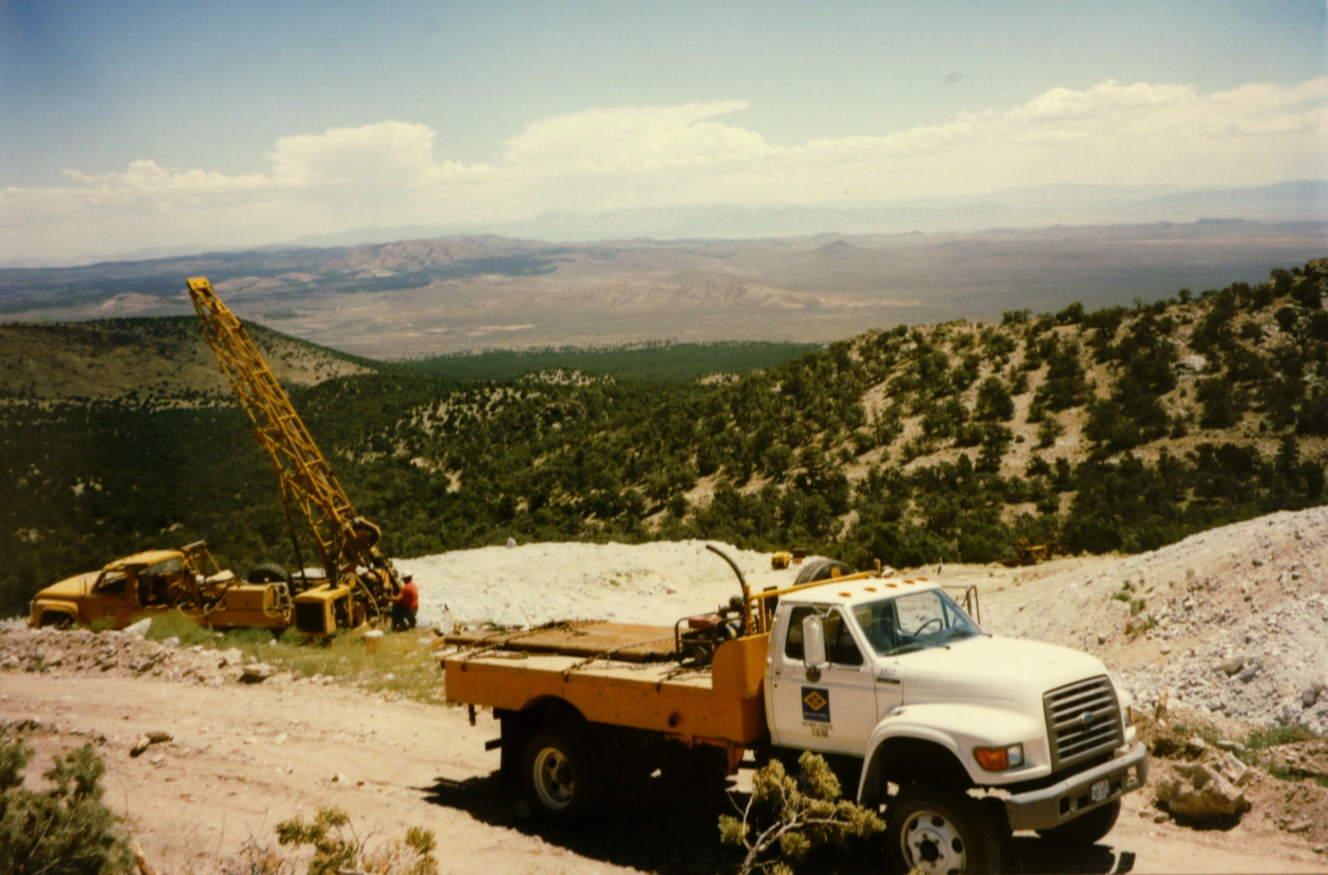
Notes:
Before Kennecott showed up in the nineties, the Harris family reported a typical annual production of 500 carats…their best year was around one thousand. During the slow periods before and after the heavily-mechanized work…the family operations might have only produced a few dozen to a hundred carats per year! One of Kennecott’s first advisory reports claimed that the initial goal of the company ought to be the creation of 2,000 carats of faceted material…which represented multiple years of work. Only then, the researcher claimed, could one truly have an accurate estimate for the distribution of weights and quality in the goods they wanted to price and sell.
I was able to amass a collection of over 2,000 carats…with enough cabochons to match Kennecott’s entire non-facet grade production, as well. The way I figured it, even if the mine never yielded much…as long as I had a few new pieces to offer the public every year, our business could be a success.
At certain times of the year, the Ruby-Violet Claims are lush with red and green…and the giant piles of white gravel remind me of home and of me. Of all the places at the mine…walking along the road that divides the two sets of claims gave me the best views. From here, one can see forever along the flat plains…and trace the mountains into an endless horizon.

Slide 19
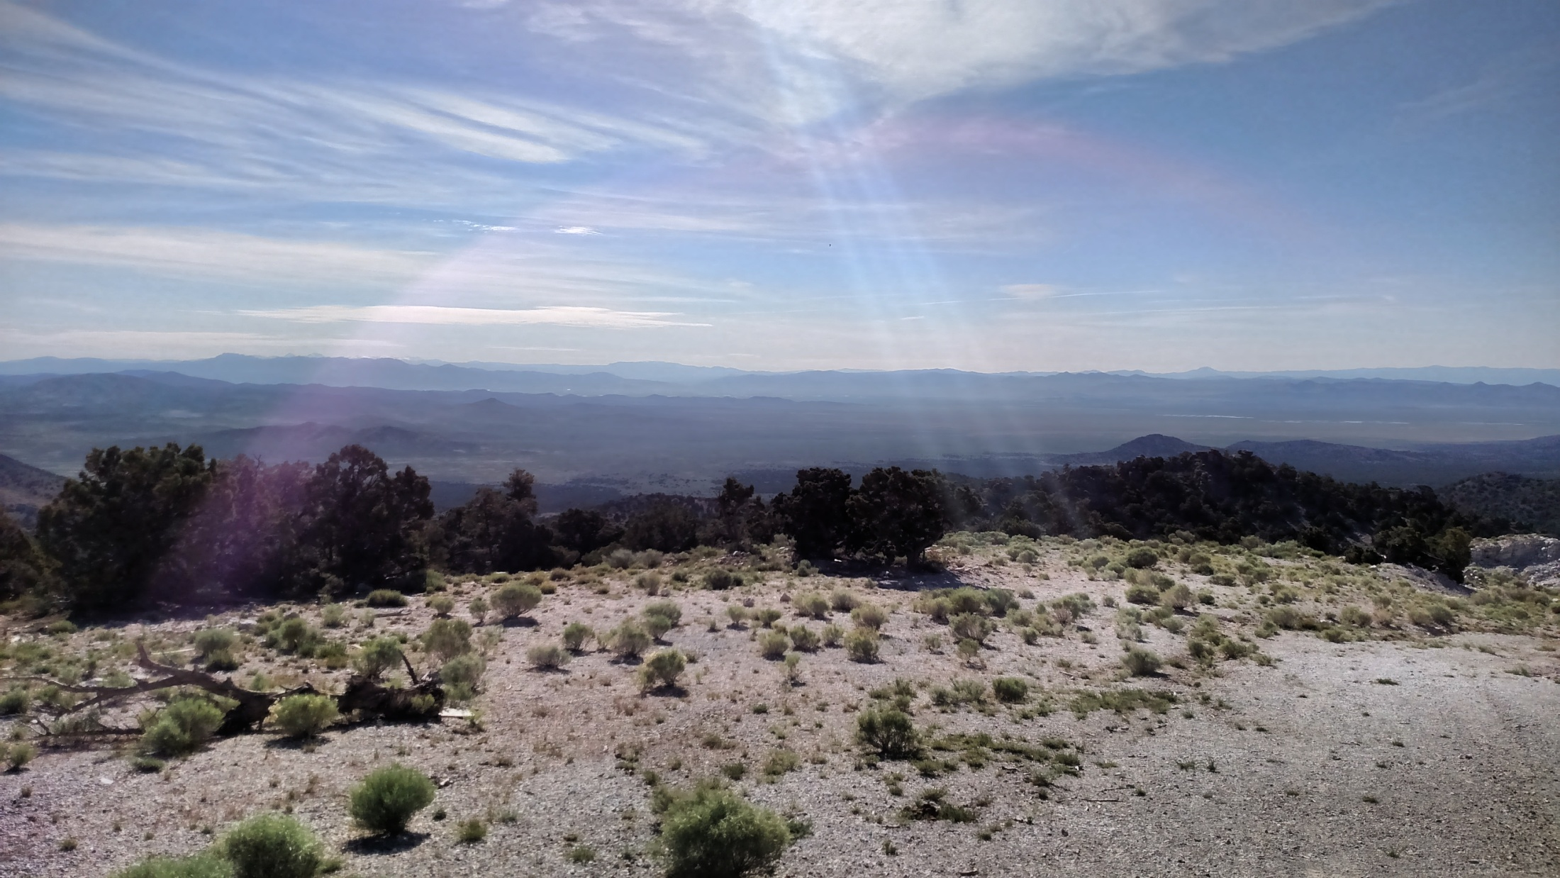
Notes:
I wish I could say this is the first time a lens-flare got incorporated into my photography…but I doubt that’s the case. It was like holding a burgundied bow with four arrows made of light…strung and pulled all the way back to Heaven. I can’t express how ‘visual music’ might be best-represented for you…but this scene captured it perfectly, for me.
Cropper claimed that every fall, biting flies descend on this place like the plague. Bob Jones complained of the “pig smell” wafting up from the farmers in the valley below. My dad, cousin and I almost dehydrated up there…and we resorted to drinking boiled cricket water out of our cooler just to stay a few hours longer (collecting materials I have yet to use). I cherished all our time out there. Sure…the conditions are a little austere. But no matter how anyone might try to badmouth this place, talk it down or disparage the conditions…if I had to run out the rest of my days on Earth somewhere, I preferred to spend as many of them as I could here.
Because, for me…the Ruby-Violet Claims are a magical place.
My dad’s friend quipped that he “should have worked for love and married for money…instead of marrying for love and working for money!” Back when I took this photo…I believed there was a way for a man’s motivation to be the best of all those things.
And the view alone (to me) was probably worth a million bucks.

Slide 20
Notes:
If this mountain no longer existed…is there any other place in the world where we might find enough red emeralds to give this stone a better happy ending?
In 2003, Lanny Ream recounted a story of tracking down a deposit of red beryl in the mountains of western Utah (Ream took Rohtert’s mountain profile picture clear back in September of 1979). It was a locality a friend told him existed…but not many others had seen at the time. He wasn’t sure the claim holders would grant him permission to visit…but he just wanted to get up there and see that red beryl for himself.
The Utah Bureau of Mines identified a previously-unreported red beryl locality in Iron County (but they were the sole report of this claim). New Mexico also has a verified deposit in the Black Range that to date has only been surface-explored. The Thomas Range has several spots besides Topaz Mountain where red beryl has been excavated (including Starvation Canyon, Wildhorse Springs and the active Holfert and Adventures claims). Merz’s Red Emerald book asserted that the Red Dog Claims were the TRUE source of fine, high-quality crystals. Red Dog Claims do exist, in fact…but no documented production figures of red beryl have ever been reported from them.
Similar dreamers with access to better financial resources certainly must exist…but where IS the perfect place for them to dig, REALLY? There are alternatives, but the cost of those…is about the same as purchasing this mine. I assume most people would just go for the ‘surer thing’…
…but even in the Wah-Wahs, success is never a guarantee.

